Slide 1
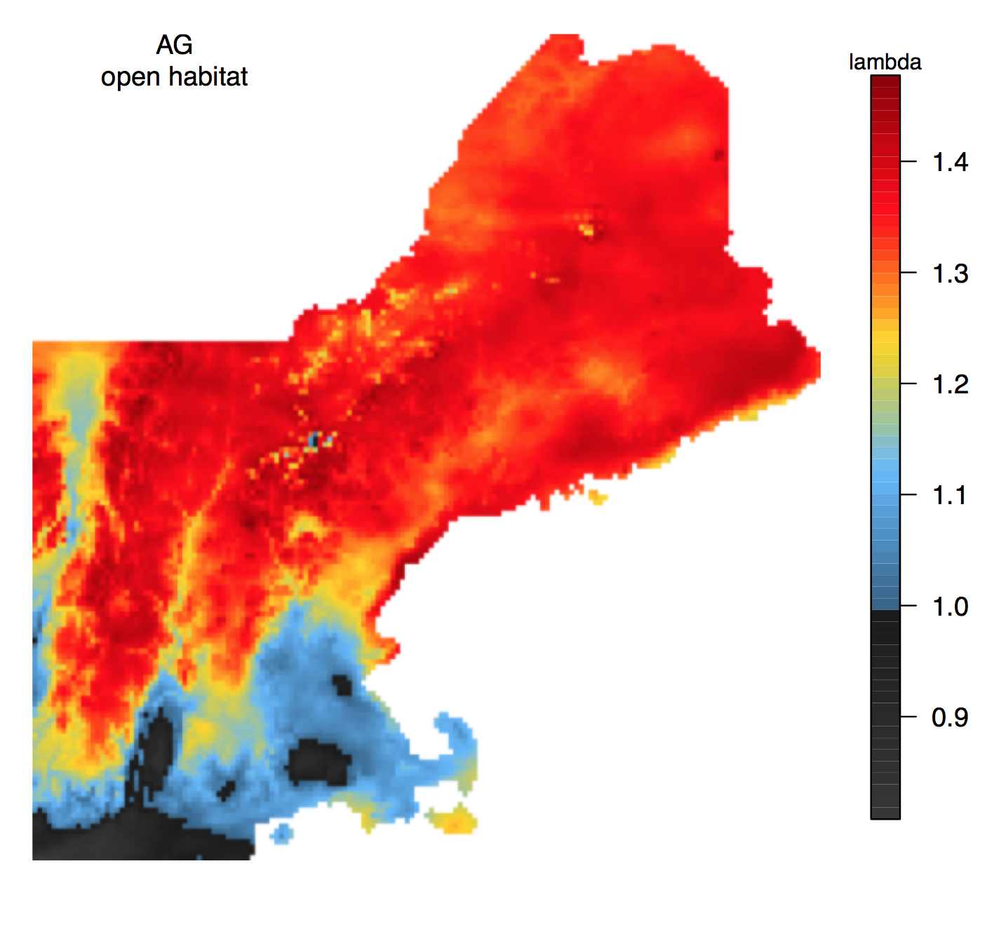
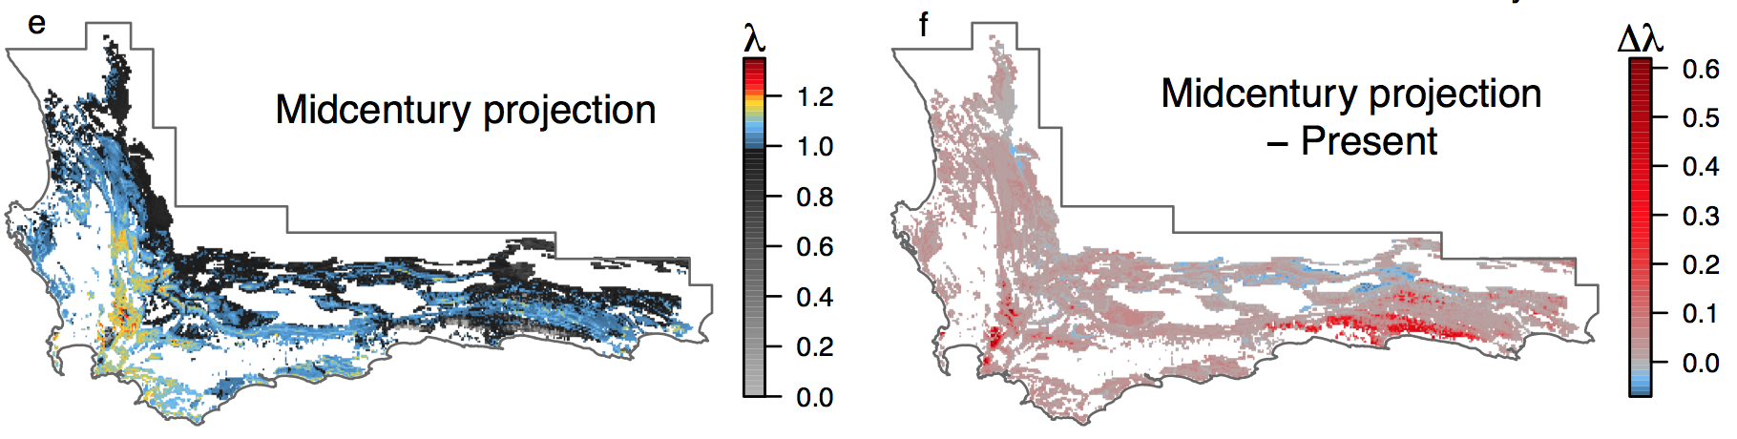
Linking Demography to Range Dynamics
Cory Merow US Fish and Wildlife Service
University of Connecticut
Sean M. McMahon Smithsonian Environmental Research Center
Notes:
I’m going to talk about a set of methods for incorporating demography into range models
Why distribution modelers should become demographers

Slide 2
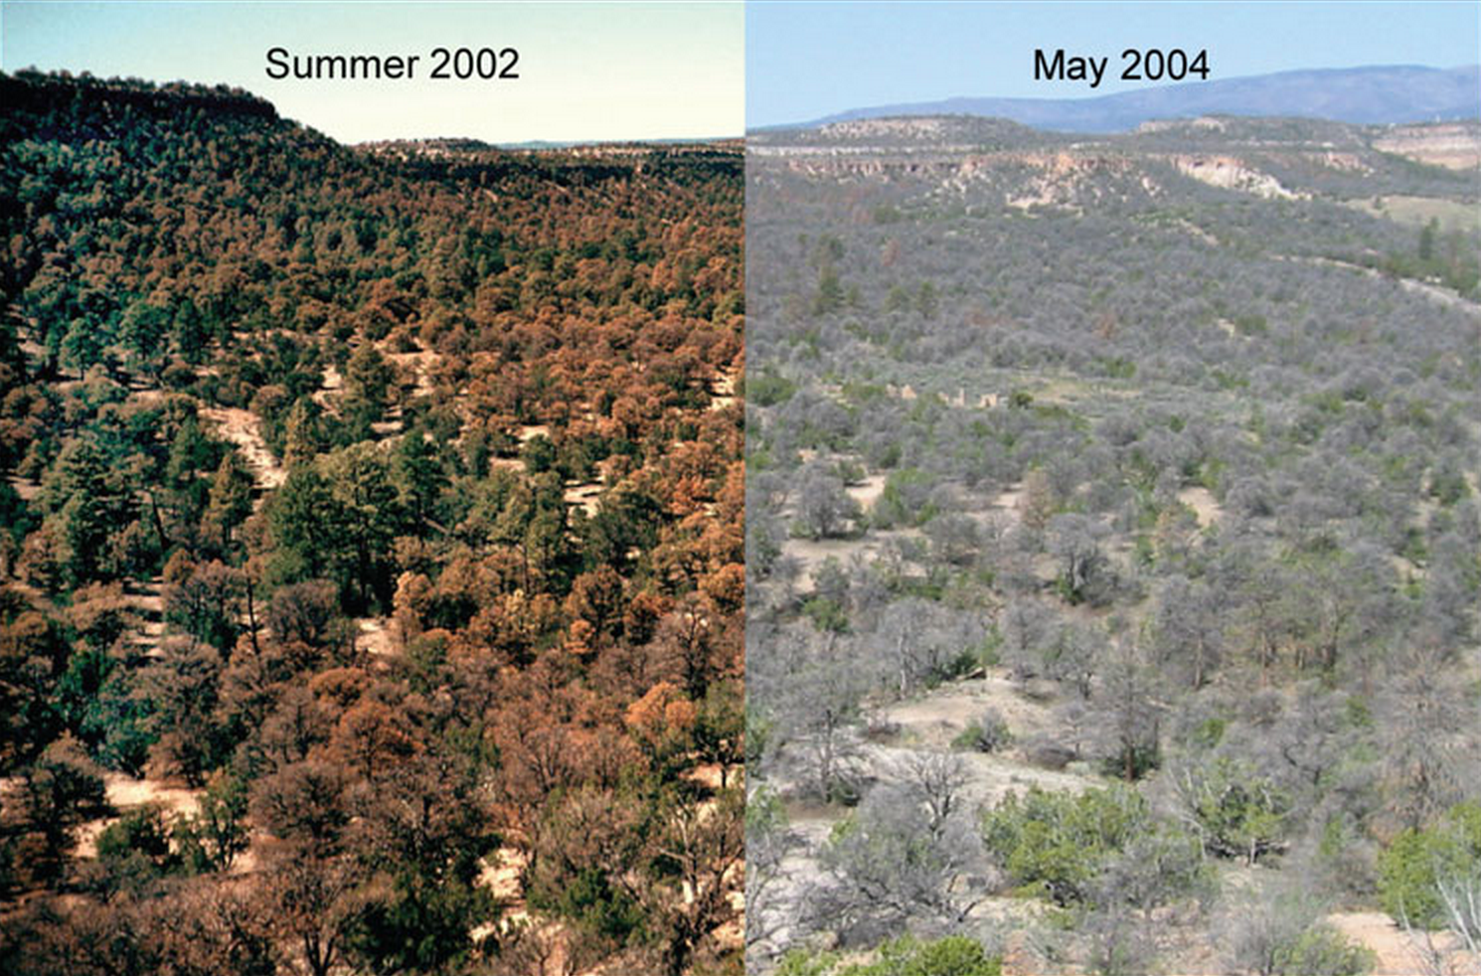
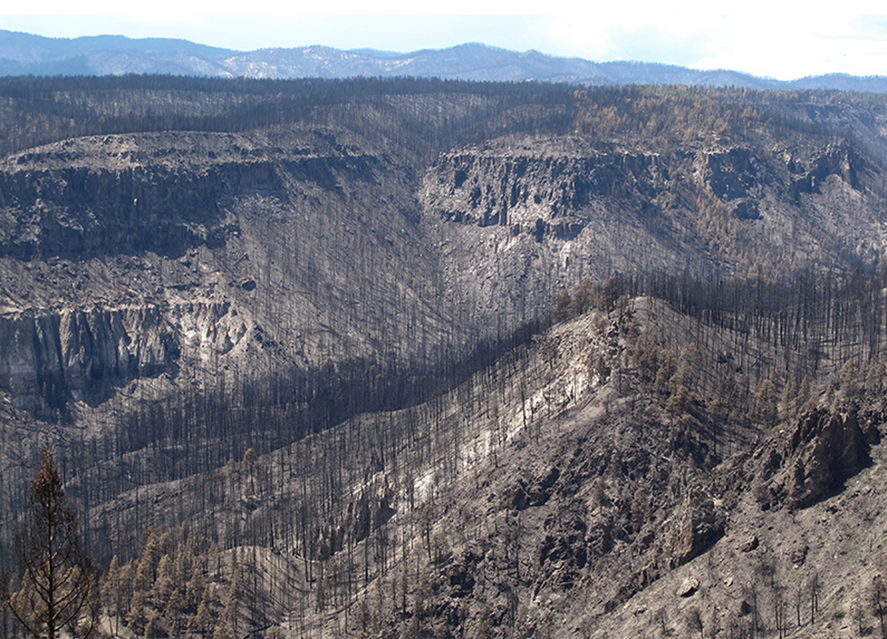
The environment is changing…
Intro IPMs Proteas Invasion Future
Craig Allen
Climate Change
Notes:
Climate – drought
http://www.southwestclimatechange.org/impacts/land/drought

Slide 3
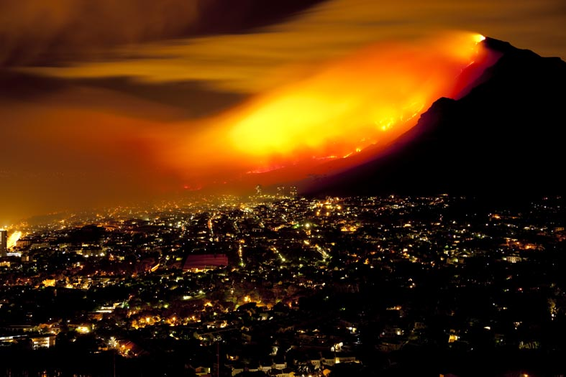
The environment is changing…
Intro IPMs Proteas Invasion Future
Craig Allen
Climate Change
Disturbance
Notes:
Disturbance
Invasion
http://www.southwestclimatechange.org/impacts/land/drought

Slide 4
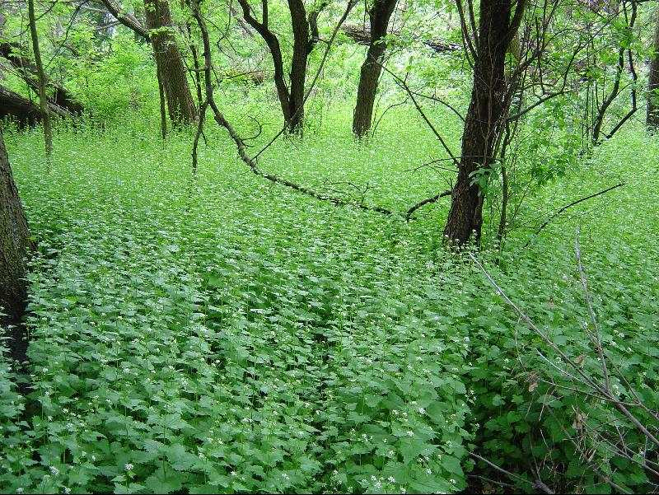
The environment is changing…
Intro IPMs Proteas Invasion Future
Craig Allen
Doug DeWitt
Climate Change
Disturbance
Invasions
Notes:
Invasion
These factors compound to make it very difficult to forecast how populations, communities and ecosystems will change
There are forecasts that involve predicting at another time, where we hope the rules about species interactions or correlation among climatic factors wont’d change. Those are hard enough. These require extrapolation in time or geographic space.
I’m interested in the forecasts that require extrapoolation to new environmental or biotic conditions that we’ve never observed.
Our only hope is with mechanism.
http://www.southwestclimatechange.org/impacts/land/drought

Slide 5
Demographic range models
Intro IPMs Proteas Invasion Future
Understanding
Vital rates (survival, growth, fecundity)
Population statistics (Pop. Growth, Life expectancy…)
Better extrapolation
Temporal patterns
Population dynamics
Disturbance
Dispersal
Notes:
-Demography is more mechanistic than occurrence

Slide 6

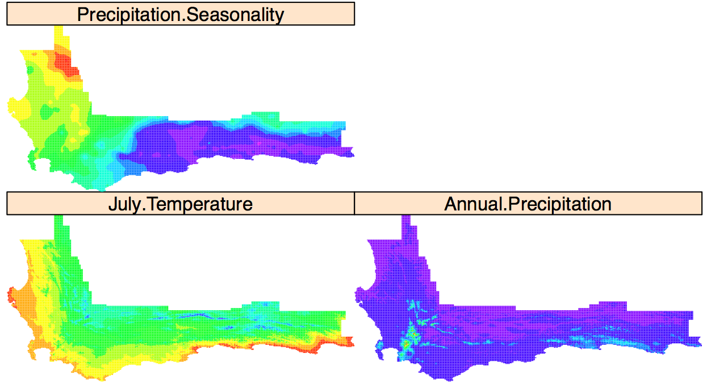
The usual range models…
Intro IPMs Invasion Future
Maxent
Software
Presences
Protea punctata
Annual Precipitation
Merow et al., 2013, Ecography; Merow et al., 2014, Ecography
Notes:
At the scale of species ranges, this is what we typically have.
Can extrapolate in space and time, and people tolerate it.
Suitable for exploring patterns, not for predicting them
Demog!=occurrence
If you have great data, this might be an occupancy model and abundance.
as we have occurrence and env, so we should be able to build statistical relationships the describe the probability that we find the species in that environment.
These would be based on niche relationships to Predict habitat suitability.
so we should be able to build a range map by which describe spatial patterns of occurrence probability, right? Then if we know something about changing environment, we just forecast it, right?
Not so simple – I’ll show you how I’ve improved it and try to steer its use in the right direction
But because its based on machine learning principles which are unfamiliar to most ecologists, it has been widely misunderstood and misused.
So I set out to explain how it works because, with the number of studies relying on it, I felt like helping others build their own models properly could have a large impact on ecology, particularly conservation.

Slide 7
The usual range models…
Intro IPMs Invasion Future
Maxent
Software
Presences
Protea punctata
Annual Precipitation
Merow et al., 2013, Ecography; Merow et al., 2014, Ecography
Notes:
At the scale of species ranges, this is what we typically have.
Can extrapolate in space and time, and people tolerate it.
Suitable for exploring patterns, not for predicting them
Demog!=occurrence
If you have great data, this might be an occupancy model and abundance.
as we have occurrence and env, so we should be able to build statistical relationships the describe the probability that we find the species in that environment.
These would be based on niche relationships to Predict habitat suitability.
so we should be able to build a range map by which describe spatial patterns of occurrence probability, right? Then if we know something about changing environment, we just forecast it, right?
Not so simple – I’ll show you how I’ve improved it and try to steer its use in the right direction
But because its based on machine learning principles which are unfamiliar to most ecologists, it has been widely misunderstood and misused.
So I set out to explain how it works because, with the number of studies relying on it, I felt like helping others build their own models properly could have a large impact on ecology, particularly conservation.

Slide 8
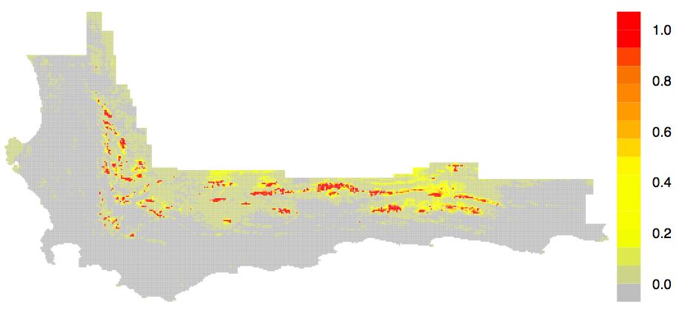
The usual range models…
Intro IPMs Invasion Future
Maxent
Software
Presences
Protea punctata
Predictions
Annual Precipitation
Occurrence
Merow et al., 2013, Ecography; Merow et al., 2014, Ecography
Notes:
At the scale of species ranges, this is what we typically have.
Can extrapolate in space and time, and people tolerate it.
Suitable for exploring patterns, not for predicting them
Demog!=occurrence
If you have great data, this might be an occupancy model and abundance.
as we have occurrence and env, so we should be able to build statistical relationships the describe the probability that we find the species in that environment.
These would be based on niche relationships to Predict habitat suitability.
so we should be able to build a range map by which describe spatial patterns of occurrence probability, right? Then if we know something about changing environment, we just forecast it, right?
Not so simple – I’ll show you how I’ve improved it and try to steer its use in the right direction
But because its based on machine learning principles which are unfamiliar to most ecologists, it has been widely misunderstood and misused.
So I set out to explain how it works because, with the number of studies relying on it, I felt like helping others build their own models properly could have a large impact on ecology, particularly conservation.

Slide 9
Demographic range models
Intro IPMs Invasion Future
Understanding
Vital rates (survival, growth, fecundity)
Population statistics (Pop. Growth, Life expectancy…)
Better extrapolation
Temporal patterns
Population dynamics
Disturbance
Dispersal*
Notes:
-Demography is more mechanistic than occurrence
-at least you’re extrapolating the process, even if you run the risk that the trend changes
-I’m focusing on the fundamental niche (but sometimes there’s competition)

Slide 10
The trouble with mechanims
Intro IPMs Invasion Future
You have to get them ALL right to forecast
Correlative models can look pretty nice, because they’re not as constrained
Notes:
Teaser; this is going to be our challenge
Can’t just get demography when dispersal limitation

Slide 11
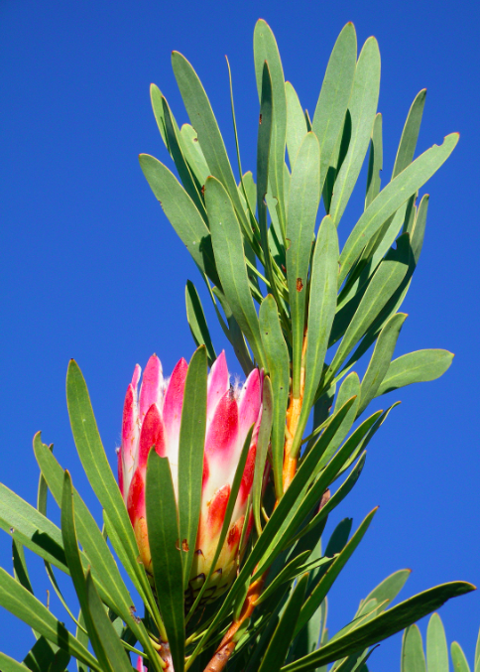
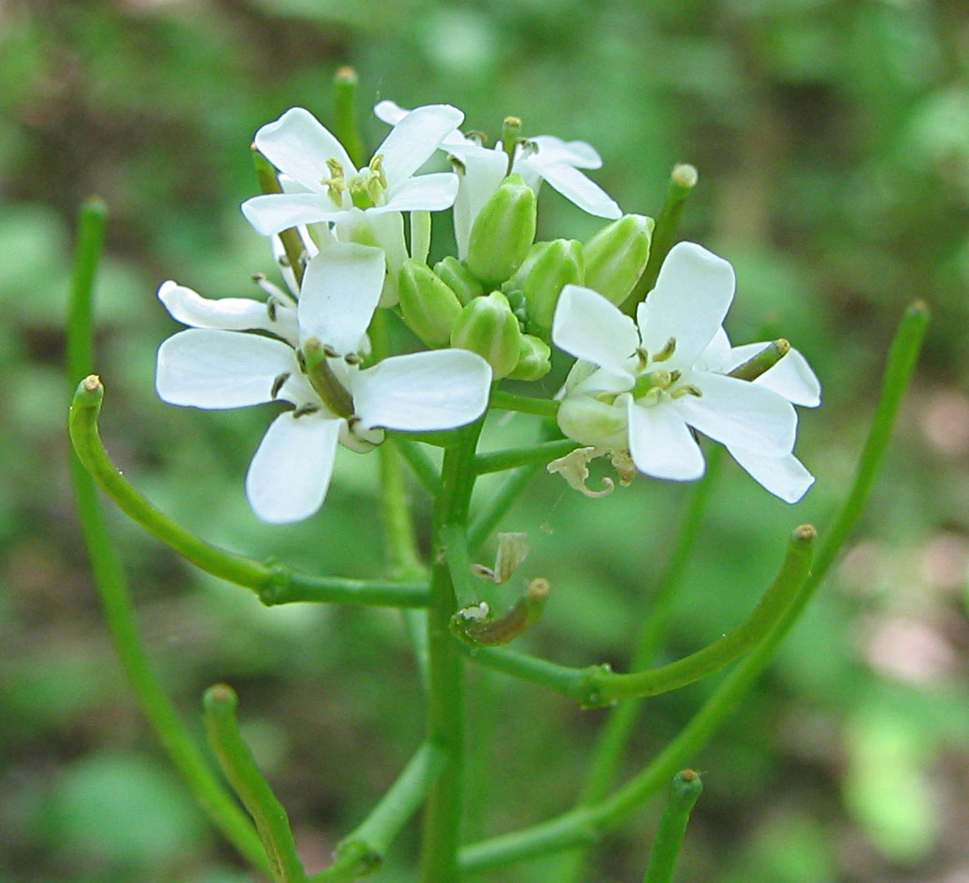
Outline
Intro IPMs Proteas Invasion Future
improve
1. Integral Projection Models
2. South African Proteas
3. Invasive herbs in New England
Notes:
-I hope to convince you that because they’re based on regressions and act like matrix projection models, they’re pretty simple.
-there are also some more complicated methods to available, such as dynamic range models, which are very appealing but require a fair amount of data and may present some technical challenges. So I want to offer options that lead to more informed distribution models but which are relatively easy to build.

Slide 12
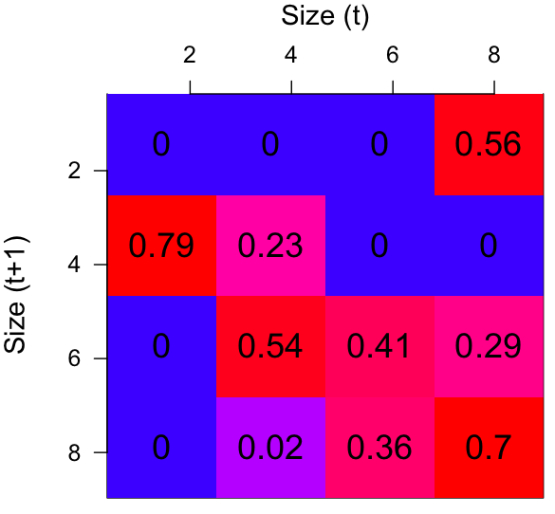
Integral Projection Models?
Intro IPMs Proteas Invasion Future
IPM
Notes:
More demographic resolution
high resolution matrix model
How do we parameterize
If we had more data, we might seek a higher resoluation model to better describe differences in individuals (show how 1 column allows for more differences)
With even more data, we could build something that’s almost conituous.
we call this the kernel and it describes almost everything we need to know about the model
Its mostly safe to think about this as a a high resolution matrix model
How do we parameterize, since we’re unlikely to observe a large number of individuals moving in and out of each cell? With regressions

Slide 13
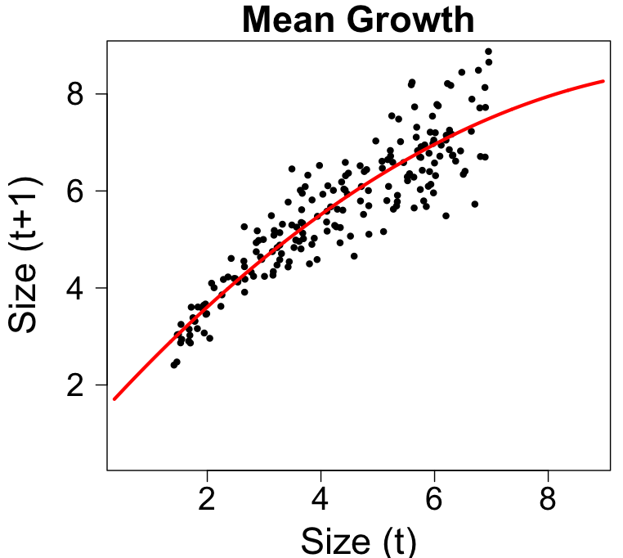
Vital Rate Regression: Growth
Intro IPMs Proteas Invasion Future
Notes:
We’ll go in to some detail on the growth regression

Slide 14
Vital Rate Regression: Growth
Intro IPMs Proteas Invasion Future

Slide 15
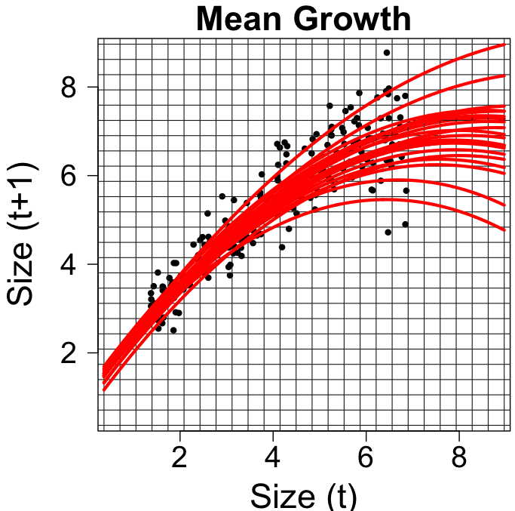
Intro IPMs Proteas Invasion Future
Notes:
These are just regressions, so we can build them with environmental covariates and get different curves in different environments
we can interpolate /extrapolate with these models
Combine inference across populations and at unobserved locations

Slide 16
Build maps of …
Intro IPMs Proteas Invasion Future
Population growth rate
Passage time to given size
Life expectancy
Size distributions
Sensitivities
Merow et al. 2014 Ecography
Notes:
Maps of these quantities are another, more mechanistic way of looking at habitat suitability.
Population growth rate describes recovery after disturbance,
Sensitivies/elasticities can identify the most fragile parts of the life history under climate change
SCALE from individual at a few locations to population patterns across a range.
POTENTIAL DISTRIBUTIONS

Slide 17
Intro IPMs Proteas Invasion Future
But where do we get the data for this?
Notes:
But Challenges with environmentally stratified demographic data
Oftne the case that we know about parts of the life history and its environmetal dependence

Slide 18
Borrow strength across environments
Intro IPMs Proteas Invasion Future
Individual Growth
Summer rainfall

Slide 19
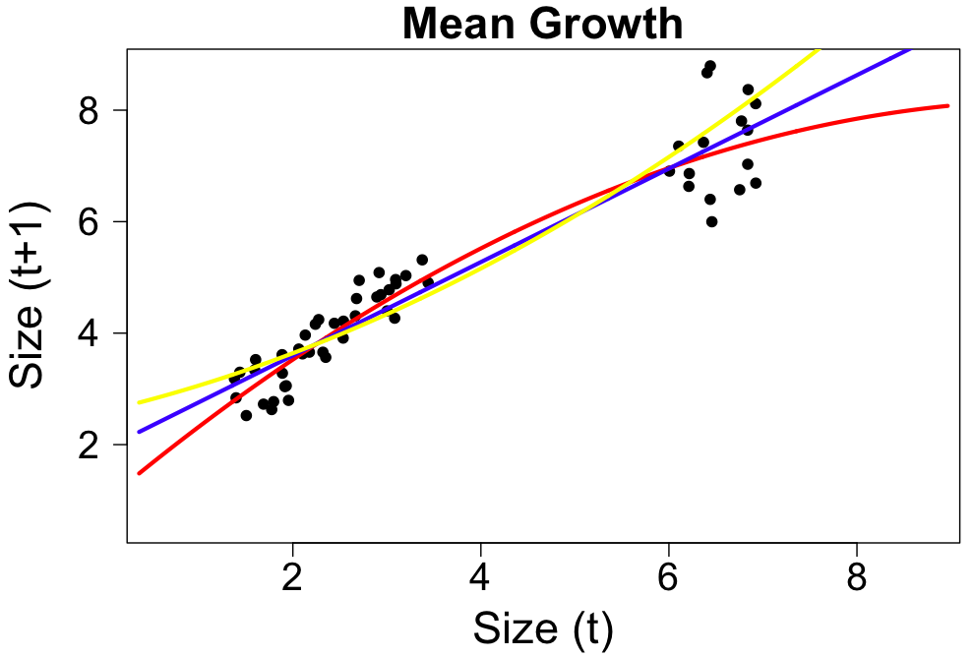
Borrow strength across stages
Intro IPMs Proteas Invasion Future
Notes:
-relatedly, we can borrow strength across stages
- with a little knowldege of the species, often pretty clear what will happen in the middle
-less clear what should happen for larger sizes

Slide 20
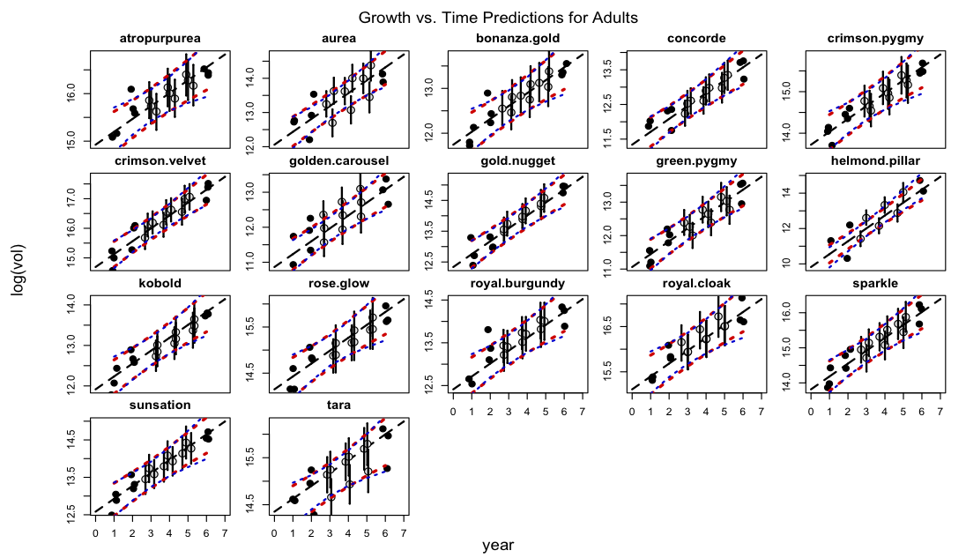
Impute transitions
Intro IPMs Proteas Invasion Future
observed
imputed
Individual
Size
Year

Slide 21
Model Variability
Intro IPMs Proteas Invasion Future
high light?
low light?
Notes:
We don’t understand variability
Could be light environment
As long as there’s no temporal autocorrelation, otherwise we need a new state variable…
Sean and I are working on incorporating time lags

Slide 22
Bayesian IPMs
Intro IPMs Proteas Invasion Future
Notes:
Model uncertainty correctly + Report interval estimates -> flexibility in piecing together data sets
-these are not huge, crazy Bayesian models, just easy little ones
-formulate hypotheses for missing data in terms of priors
-Gibbs sampling allows us to track covariance among parameters in complex models
-Choose realistic combinations of parameters for simulations
-Can also partition variation in lambda into the proportion due to variability and uncertainty like margaret has done wish Bayesian matrix models

Slide 23
Intro IPMs Proteas Invasion Future
Understanding range dynamics in south african Proteas
Cory Merow^{1,5}
Andrew Latimer²
Adam Wilson³
Sean McMahon¹
Anthony Rebelo⁴
John Silander¹
¹ Smithsonian Environmental Research Center
² University of California, Davis
³ Yale University
⁴ South African National Biodiversity Institute
⁵ University of Connecticut
Notes:
I’m going to talk about a set of methods for incorporating demography into range models
Why distribution modelers should become demographers

Slide 24
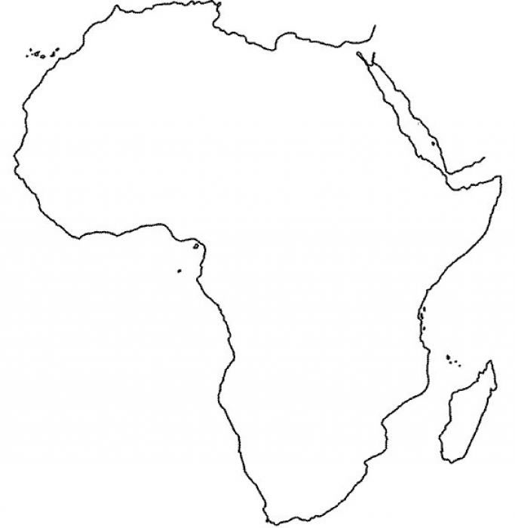
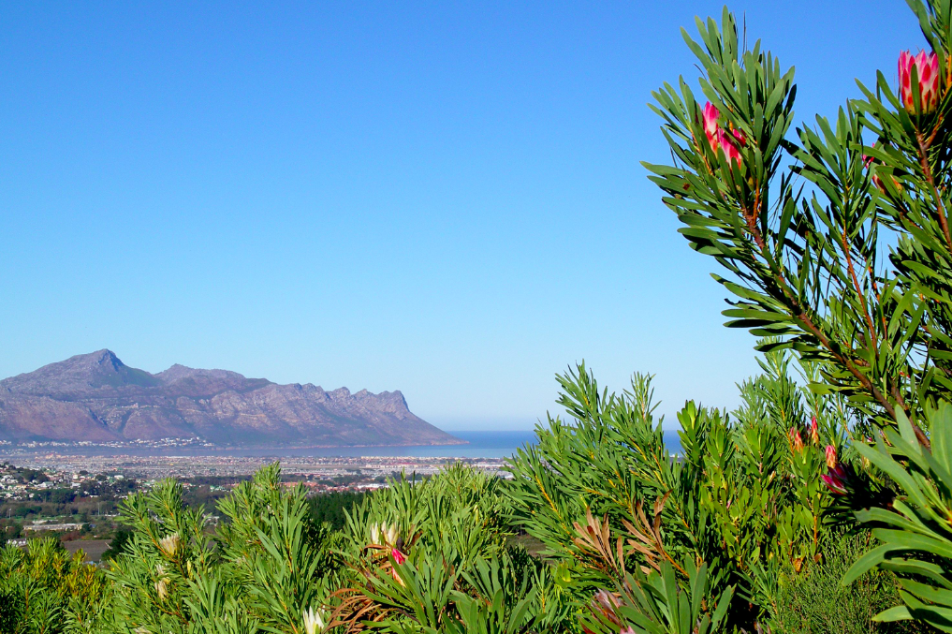
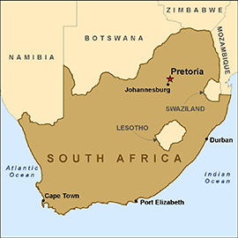
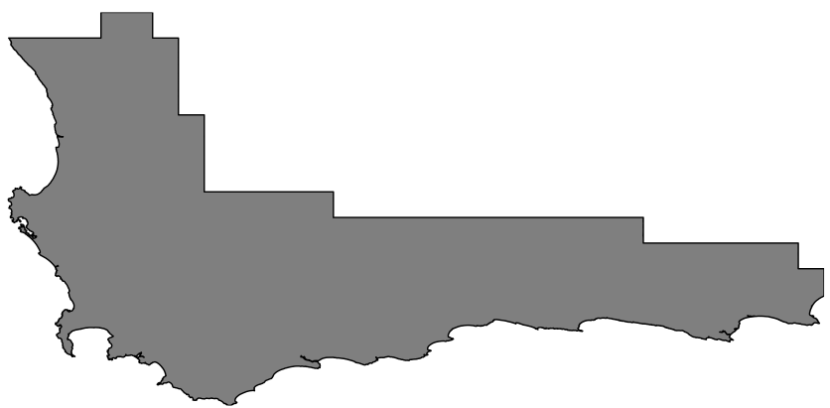
Case Study – Protea repens
Intro IPMs Proteas Invasion Future
Photos: Adam Wilson

Slide 25
Objectives
Intro IPMs Proteas Invasion Future
Predict range from demography?
Response to climate change?
Response to fire change?
Notes:
1. too many other processes?
2. Future
3.Management
4. regionally specific management. Ecotypic variation

Slide 26
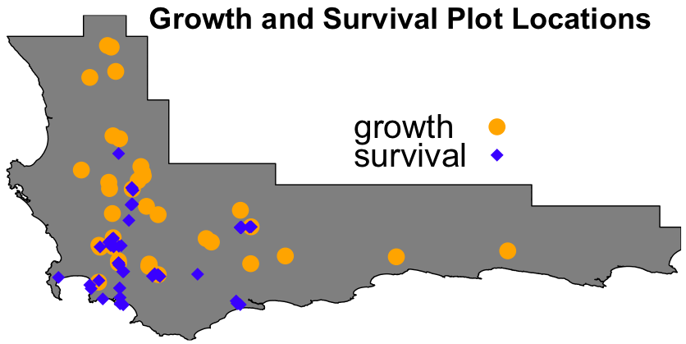
Data
Intro IPMs Proteas Invasion Future
Predictor variables
Mean annual precip.
Min. July temp.
Max. January temp.
Precipitation seasonality
Winter soil moisture days
% High fertility soil
% Fine texture soil
% Acidic soil
fecundity/

Slide 27
Data
Intro IPMs Proteas Invasion Future
Predictor variables
Mean annual precip.
Min. July temp.
Max. January temp.
Precipitation seasonality
Winter soil moisture days
% High fertility soil
% Fine texture soil
% Acidic soil
fecundity/
Notes:
best.var=c('max01','min07','map','rainconc','smdwin','ph1','fert4','text1')

Slide 28
Vital rate models
Intro IPMs Proteas Invasion Future
Growth
Average growth/year ~ Environment
Notes:
We’re not talking about these variables, just what they are
Used stepwise DIC variable selection
Avg growth after disturbance (growth increment)

Slide 29
Vital rate models
Intro IPMs Proteas Invasion Future
Growth
Average growth/year ~ Environment
Survival
% Survival ~ Size + Environment
Notes:
Surival – parent seedling ratios where we impute the number of germinatns and adult mortality transects where we impute size from age. I can talk more about this if anyoen is interested.

Slide 30
Vital rate models
Intro IPMs Proteas Invasion Future
Growth
Average growth/year ~ Environment
Survival
% Survival ~ Size + Environment
Fecundity
Flowering Probability ~ Size + Environment
# Flowers/Individual ~ Size + Environment
Seeds/Flower = 74
Germination = 1.1%
Offspring size
Size ~ Environment
Notes:
some we dont model as a function of env because we don't know about thier differences
Germination was a bit of complicatate model where we imput the number of seeds based on parent size for site 1 year after burn.
All of these measurements were made with a single visit. Plenty of problems, but helps us to ask lots of better questions and get an idea of what new data we need to collect to refine distribution and understanding

Slide 31
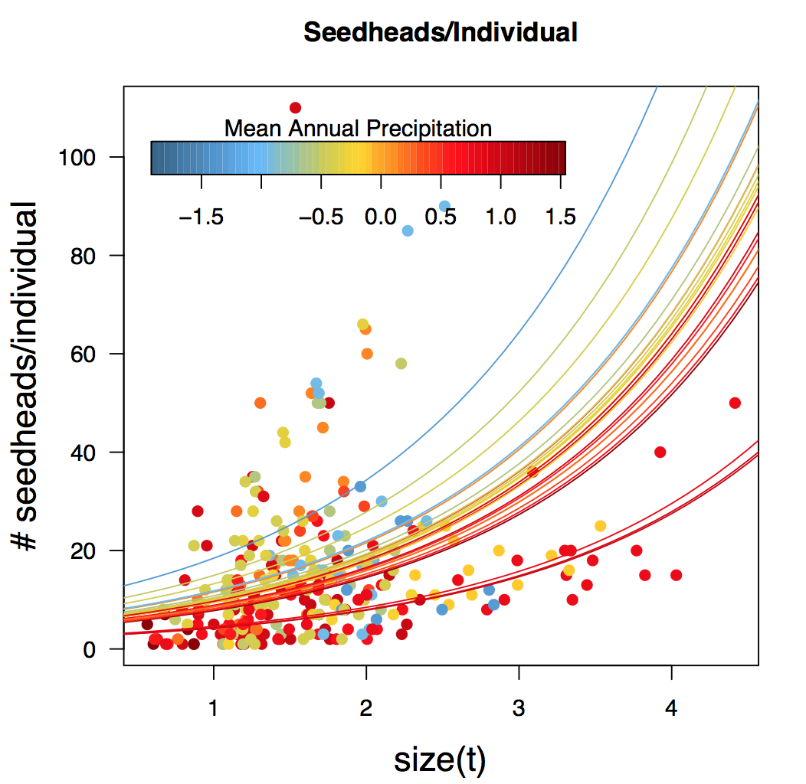
Vital Rate Models
Intro IPMs Proteas Invasion Future
Notes:
We can interpret these response curves just like we interpret response curves for occurrence models, but with the advatange that we’re focusing on a single demographic process. This makes extrapolation
You could at least do an experiment with this.
A size^2 term ensures that we don’t predict a ridiculous number of seedheads for the largest individuals (the largest had 110)
We don’t have to worry about what goes for individuals>size 5 because they don’t survive that long.

Slide 32
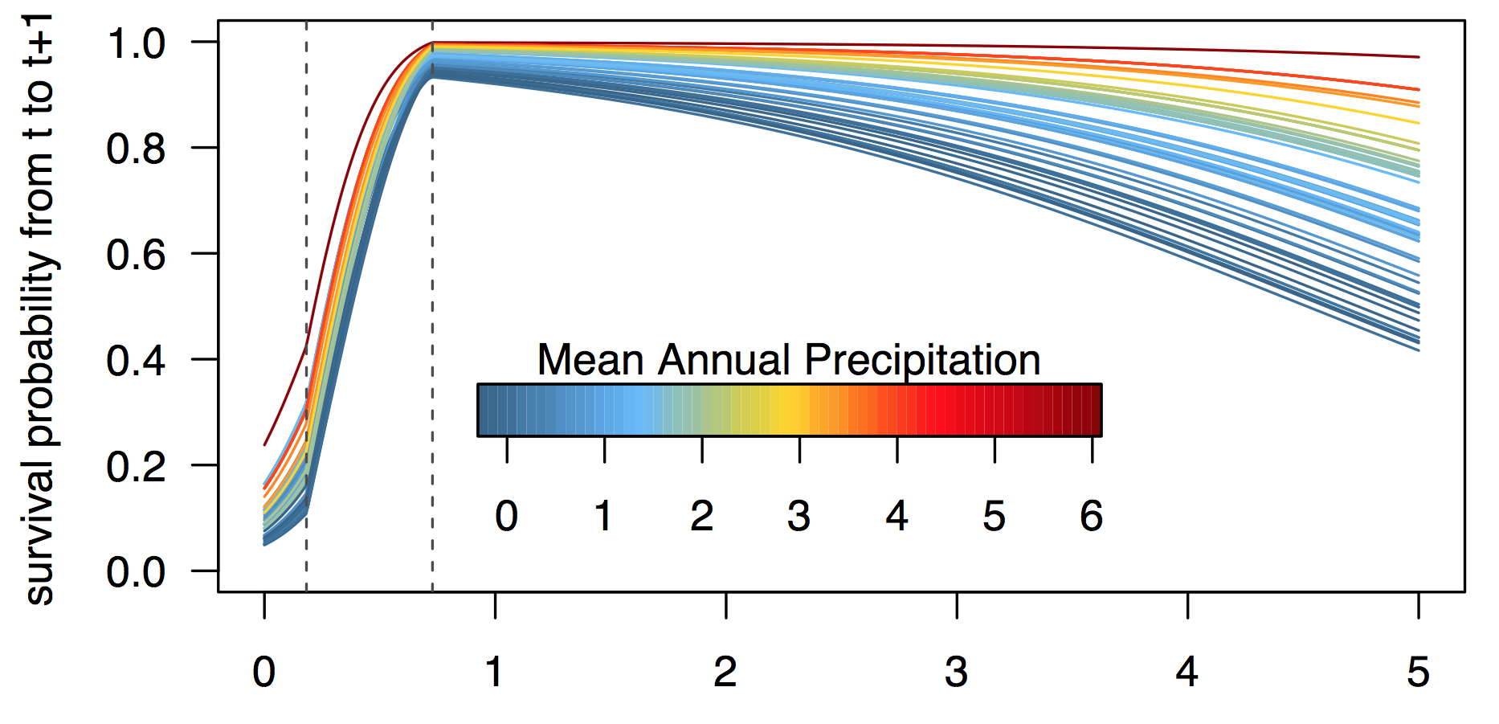

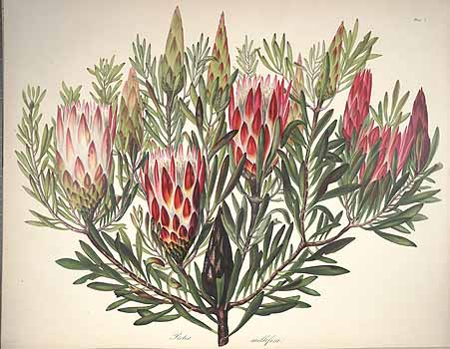

Vital Rate Models
Intro IPMs Proteas Invasion Future
size(t)
N
N
time
Notes:
-requires some creativity to stich together data sets from different places to get these results
This is a great data set, but still falls short when we try to answer cutting edge questions. Here’s how we get more out of it
Stich 2 models
We imputed parent size, seed production, and simulated survival
Felxibility comes from modeling a handful of interactions between size and environment.
A size^2 term ensures that we don’t predict a ridiculous number of seedheads for the largest individuals (the largest had 110)
We don’t have to worry about what goes for individuals>size 5 because they don’t survive that long.

Slide 33
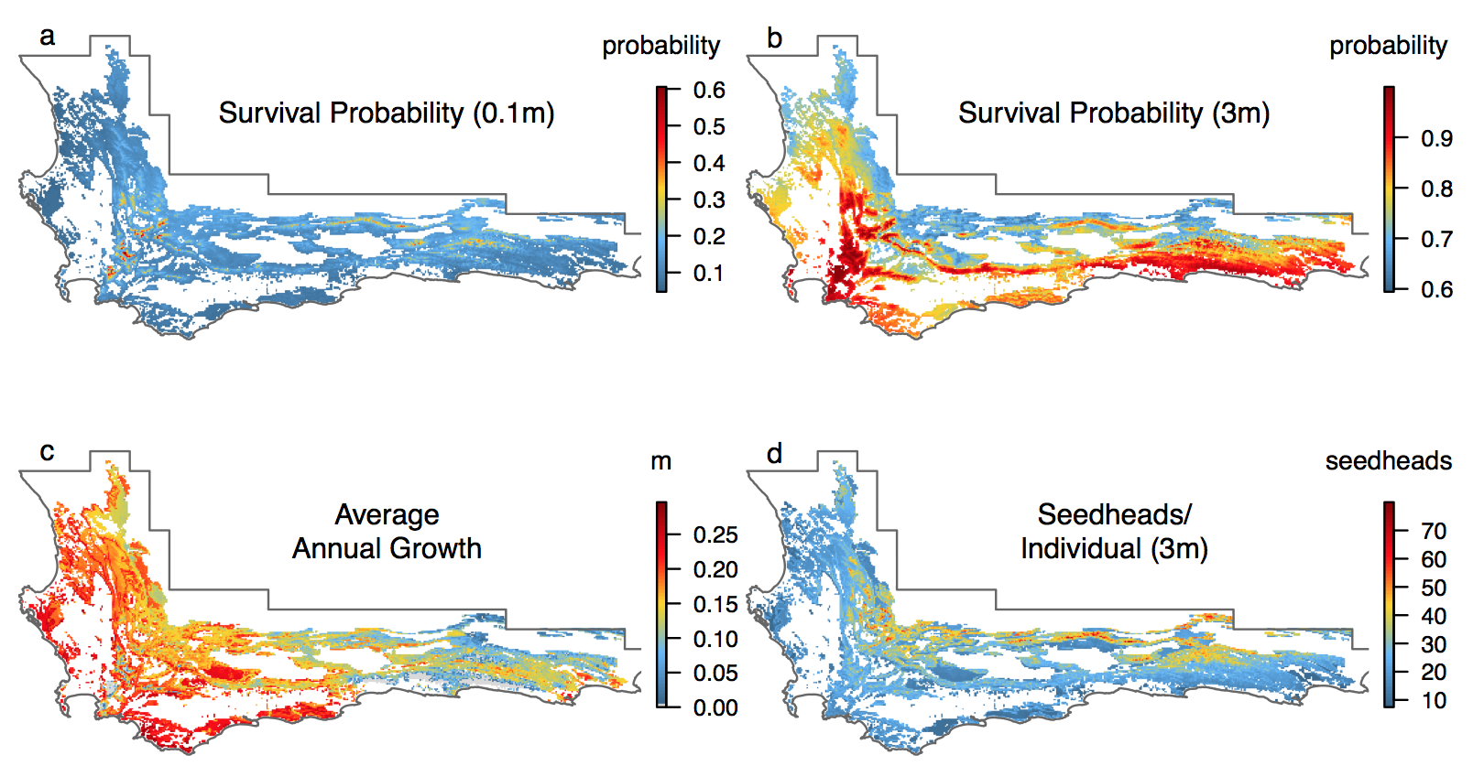
Intro IPMs Proteas Invasion Future
Notes:
Impute the seedlng survival based on parent-seedling data, growth and fecundity models
Seedhead diff than growth/ surv

Slide 34
Predictions
Intro IPMs Proteas Invasion Future
71% presences correct
70% absences correct
AUC=0.79
Notes:
Extrapolation in the eastern part of the range

Slide 35
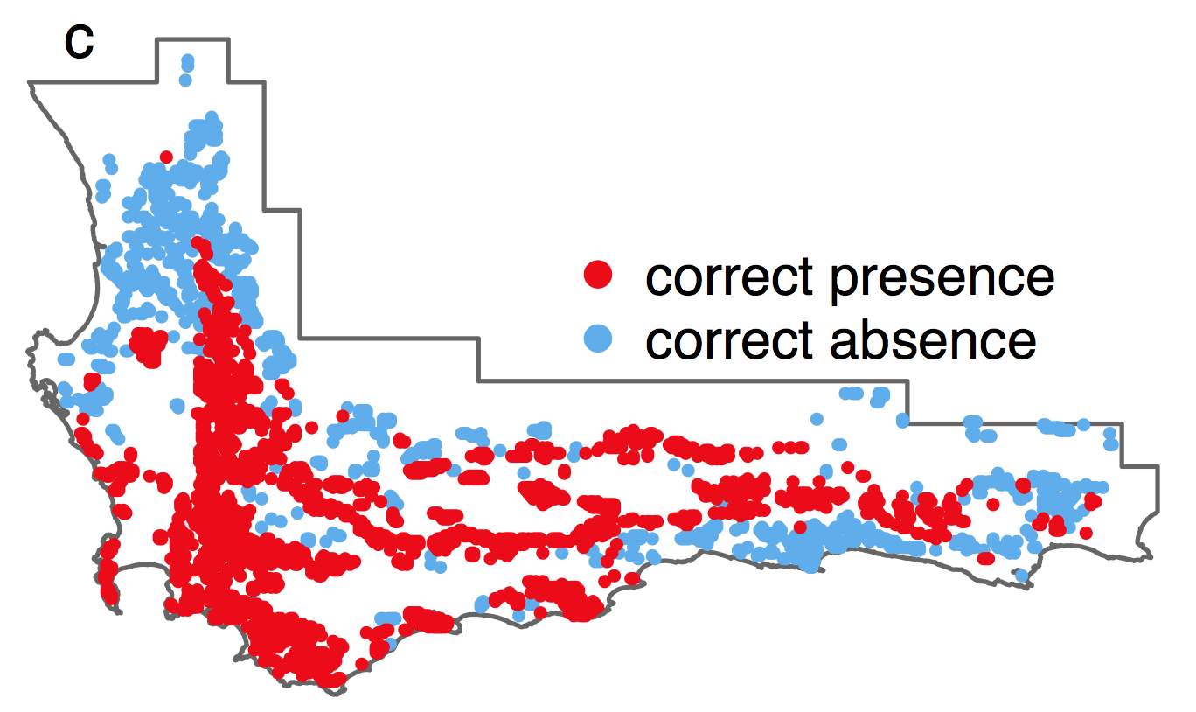
Predictions
Intro IPMs Proteas Invasion Future
Notes:
Smdwin dips in the northeast affecting survival and january temp causes dip in flowering-both unimodal– maybe not reasonable

Slide 36
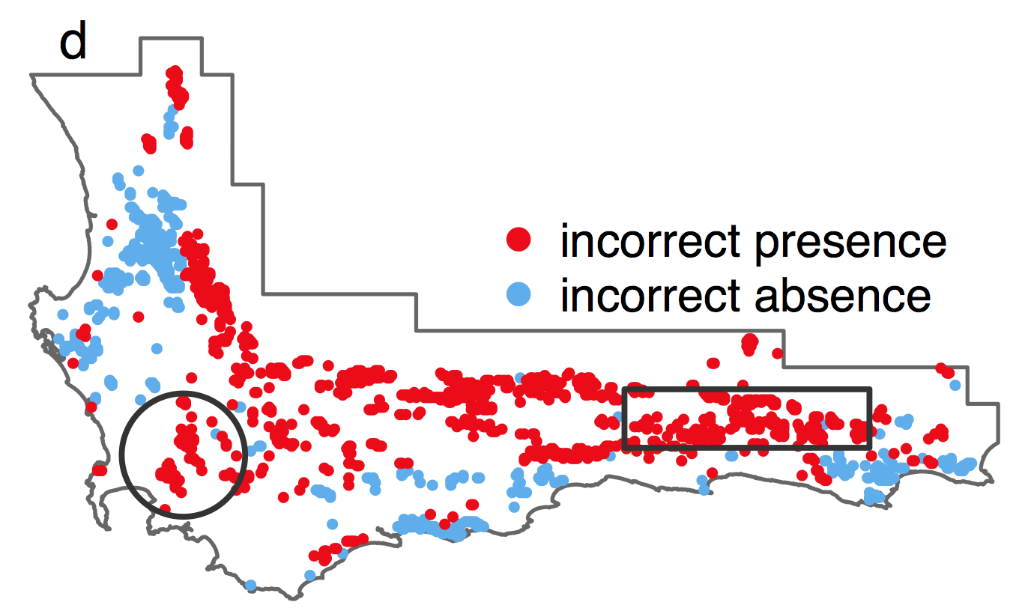
Intro IPMs Proteas Invasion Future
Predictions
Notes:
Smdwin dips in the northeast affecting survival and january temp causes dip in flowering-both unimodal– maybe not reasonable

Slide 37
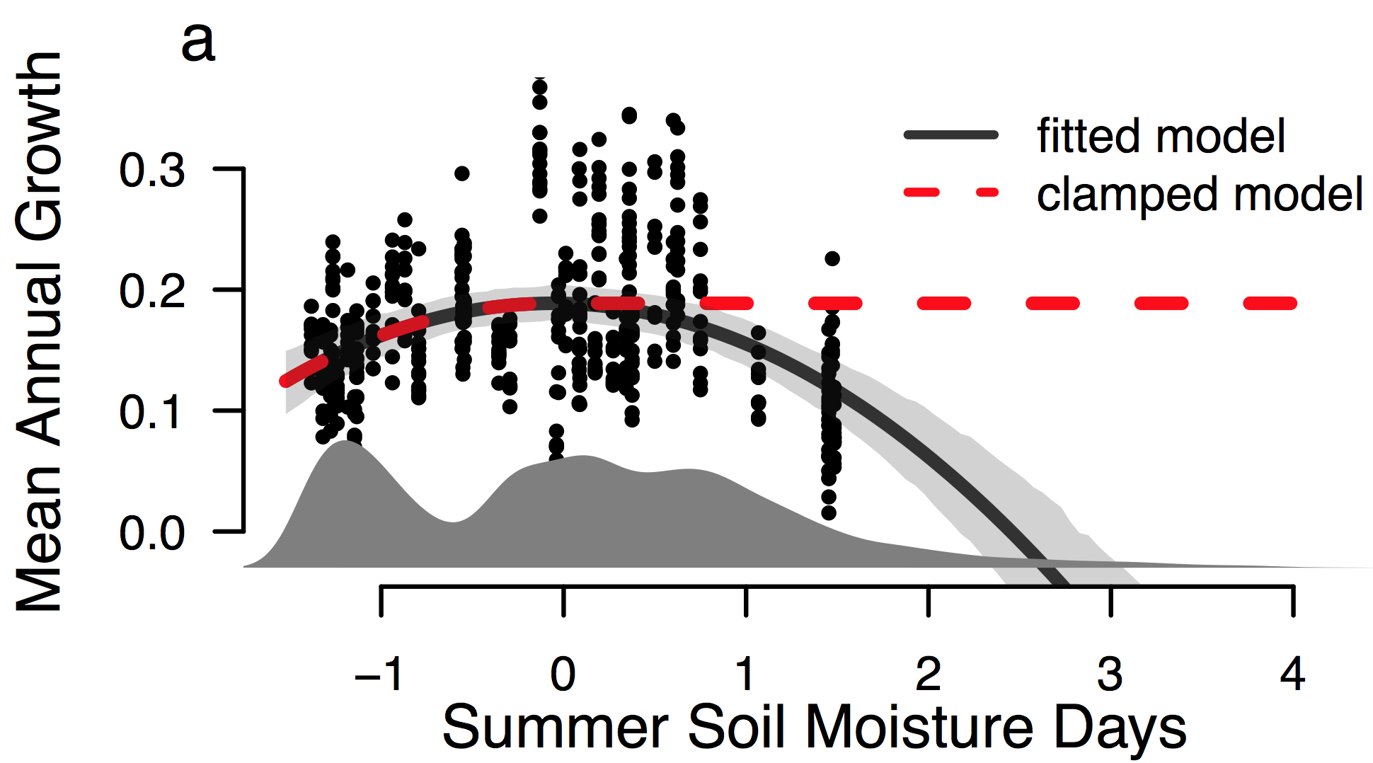
Predictions
Intro IPMs Proteas Invasion Future
Notes:
Smdwin dips in the northeast affecting survival and january temp causes dip in flowering-both unimodal– maybe not reasonable

Slide 38
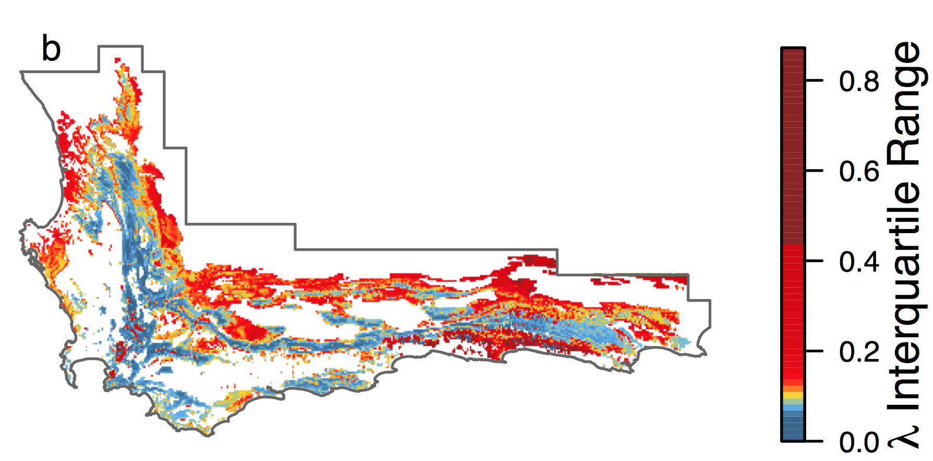
Predictions
Intro IPMs Proteas Invasion Future

Slide 39
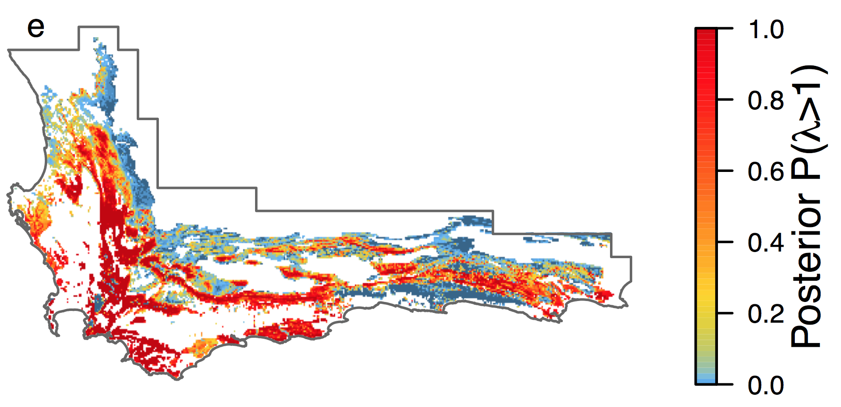
Predictions
Intro IPMs Proteas Invasion Future

Slide 40
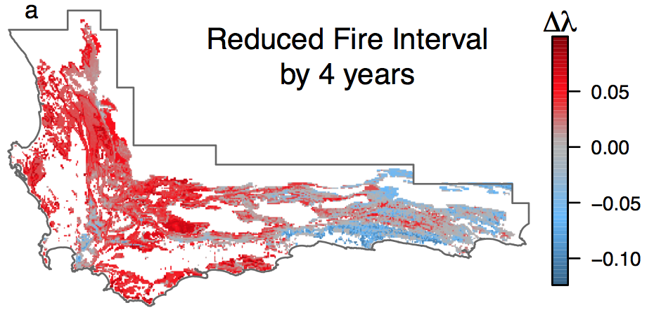
Forecasts
Intro IPMs Proteas Invasion Future
Merow et al. 2014 Ecography
Notes:
Can simulate temporal dynamics
Seem to be happiest with an 18-24 year interval, although most are in the 12-14 range
More reproduction before senescence kicks in the dryer regions
More biomass from this guy could increase fires further
Negative impact on other species
We could even relate these to weather instead of average climate, which is the next step
As climate gets hotter and dryer, we’re not sure if fire return times will increase due to increase in ignitions or lower due to slower biomass accumulation
Next step is to include heterogeneity in fire times based on environment
% landscape with lambda >1 20, 30, 32,21
EMPHASIZE!! Positive feedback for more frequent fires – if too frequent, then some species will not complete their life cycle and go extinct

Slide 41
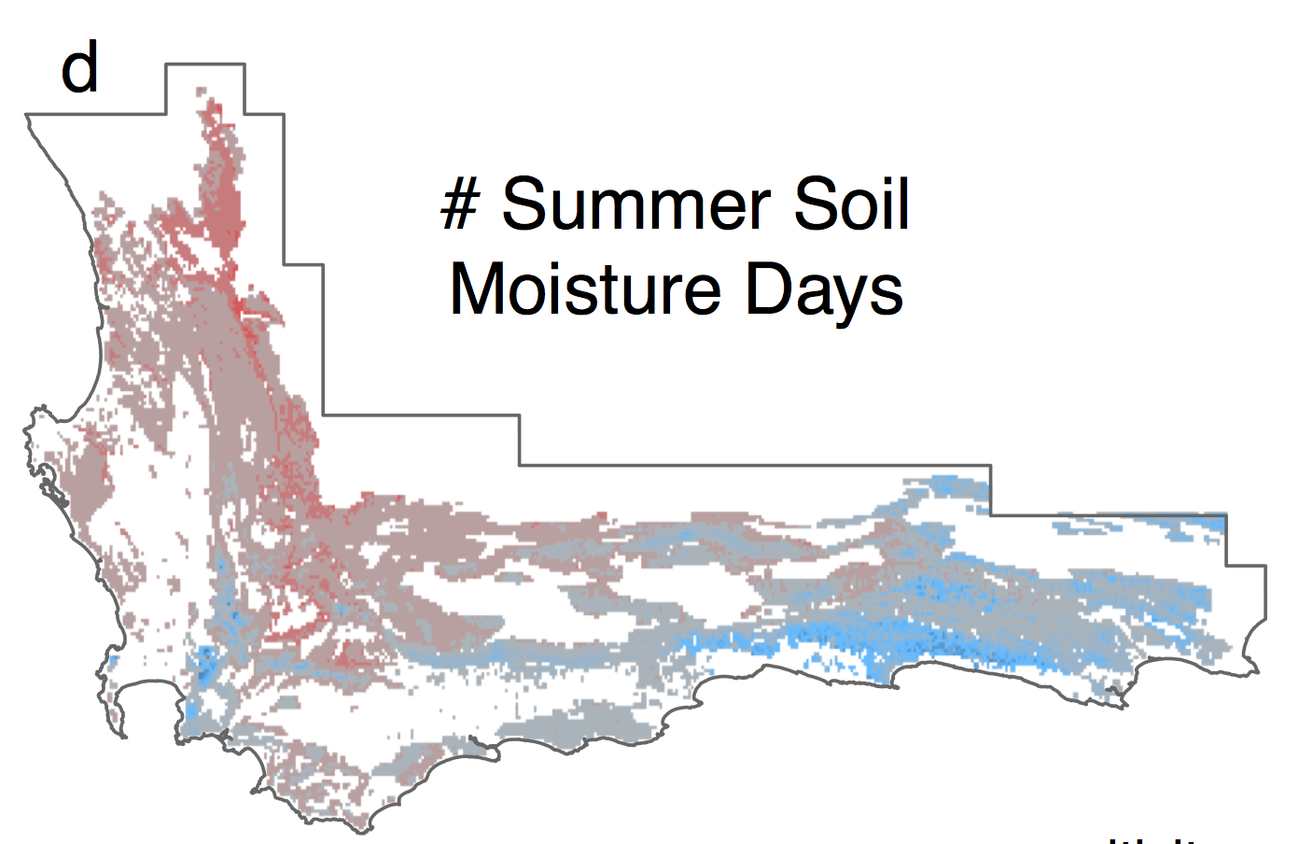
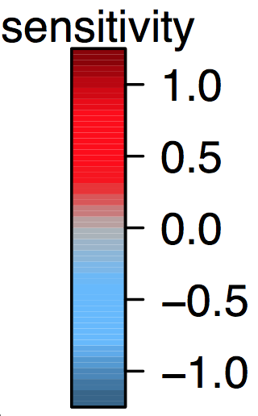
Intro IPMs Proteas Invasion Future
Sensitivity to Summer Rainfall

Slide 42

Intro IPMs Invasion Future
Increased temperatures in New England will both facilitate and restrict the range of invasive plants
Cory Merow¹
Sarah T. Bois²
Jenica Allen³
Yingying Xie¹
John Silander¹
¹ University of Connecticut
² Linda Loring Nature Foundation
³ University of New Hampshire
λ
Notes:
This project is all about forecasting
invasive species in new england

Slide 43
Invasions require extrapolation
Intro IPMs Proteas Invasion Future
Competition?
?
Thermal tolerance?
?
Notes:
Always extraplating in geographic space, often in environmetnal space too

Slide 44
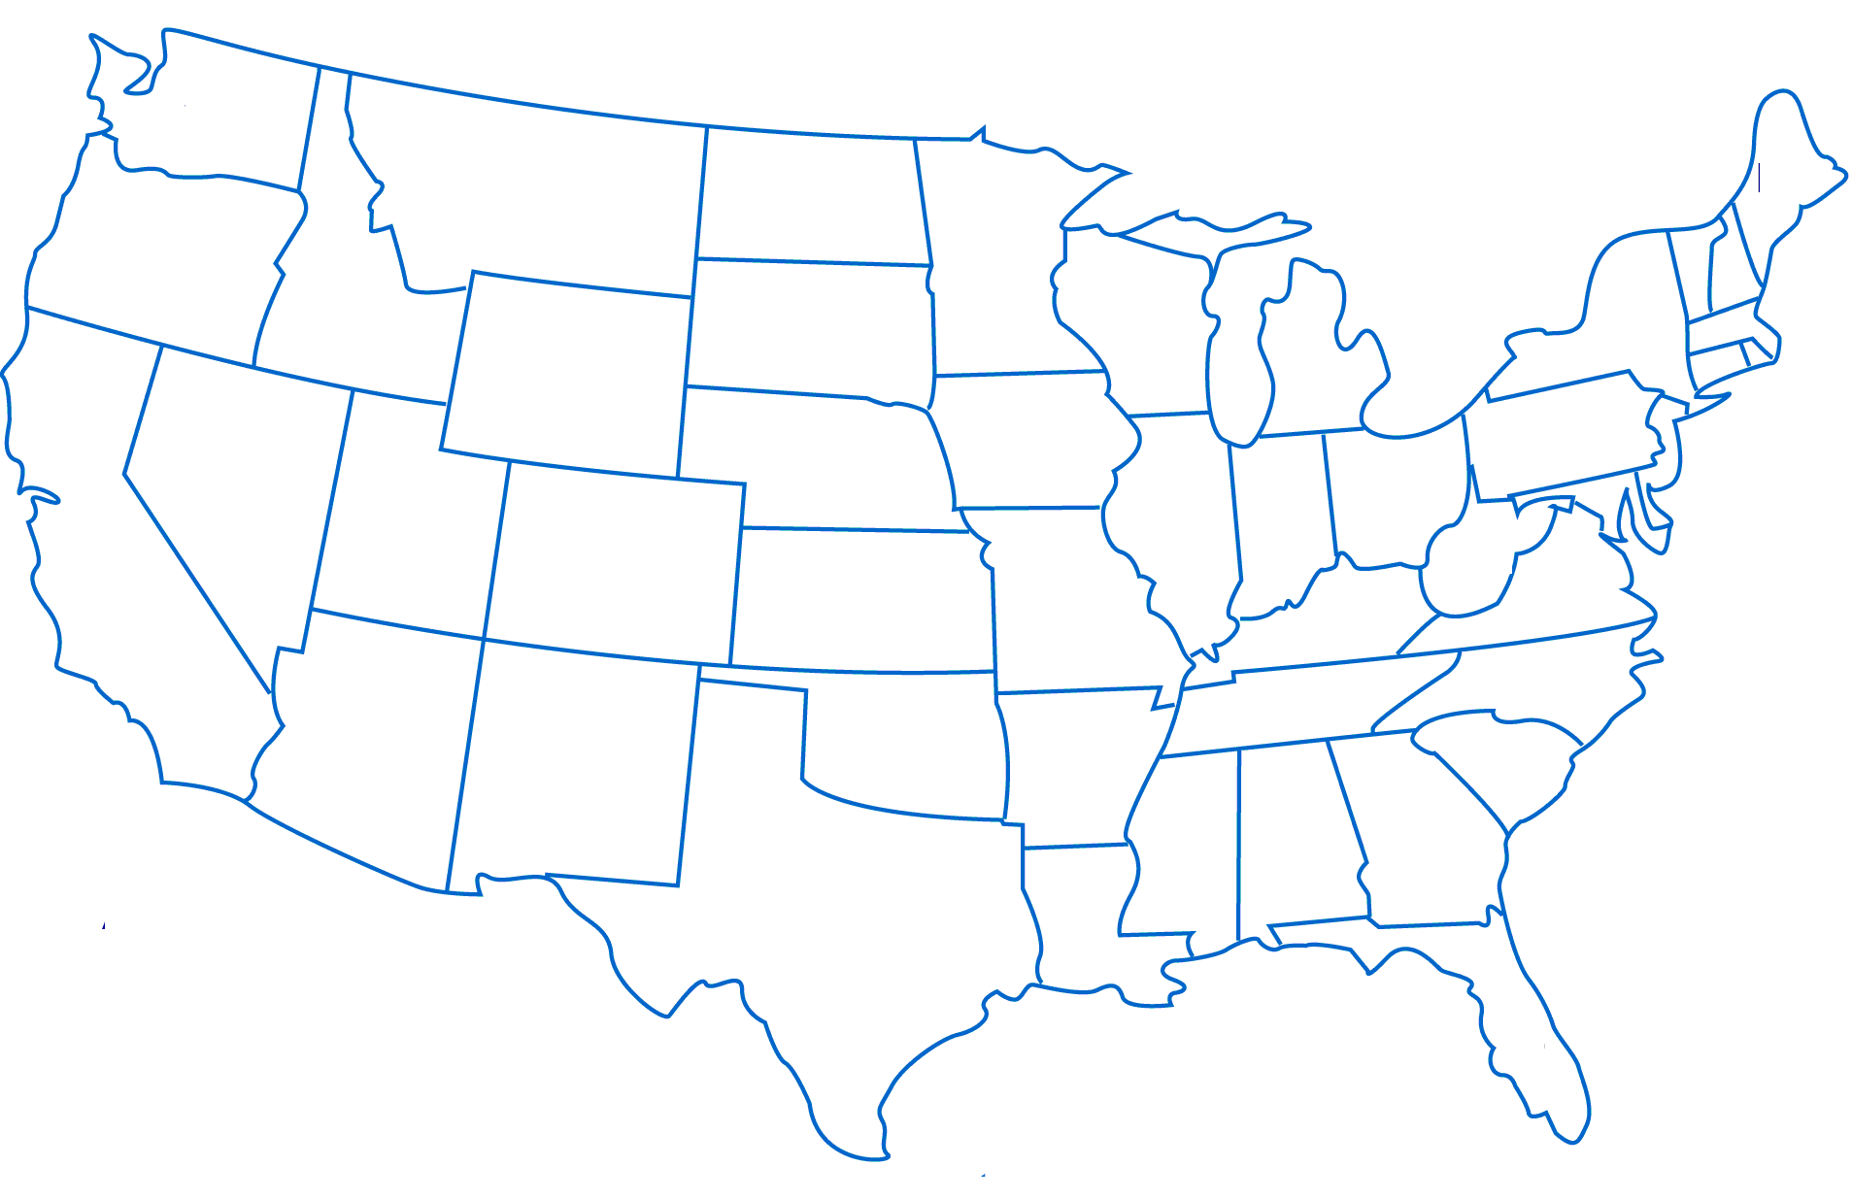
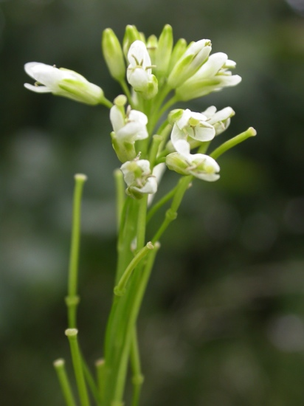
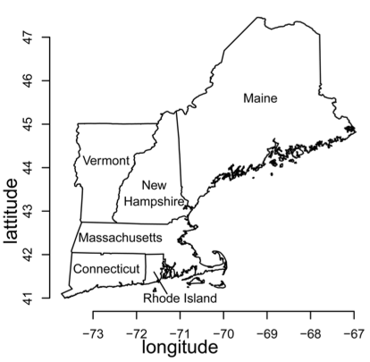
Case Study – Mustards
Intro IPMs Invasion Future
Invasive
Garlic Mustard
Alliaria petiolata
Native
Tower Mustard
Arabis glabra
Merow, Bois, Allen, Xie, Silander. Submitted
Notes:
Two bienniels,
Garlic :widespread
edge and understory
Tower: edge
Understand demographic basis for invasion; vacant niche?

Slide 45
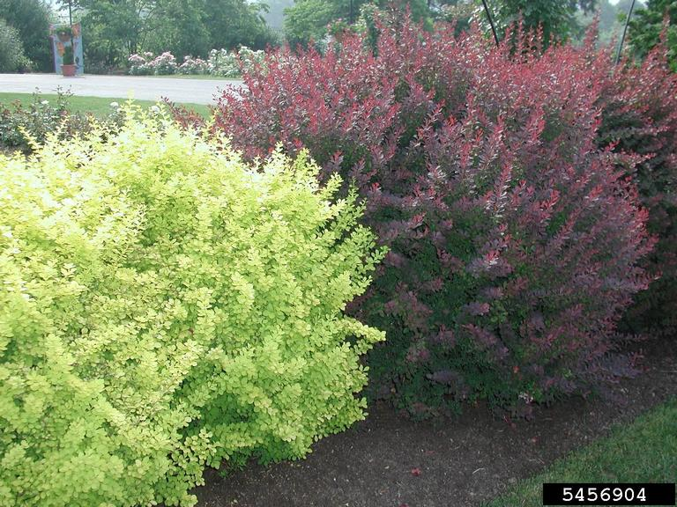
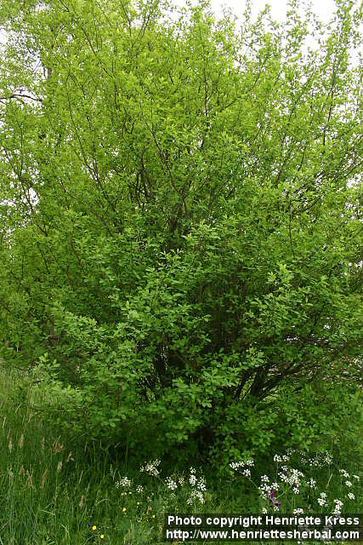
Case Study – Woody shrubs
Intro IPMs Invasion Future
Invasive
Japanse barberry
Berberis thunbergii
Native
Spicebush
Lindera benzoin
Merow, Bois, Allen, Xie, Silander. Submitted
Notes:
Barberry: edge and understory
Spicebush: moist understory mainly
Won’t get into these too much

Slide 46
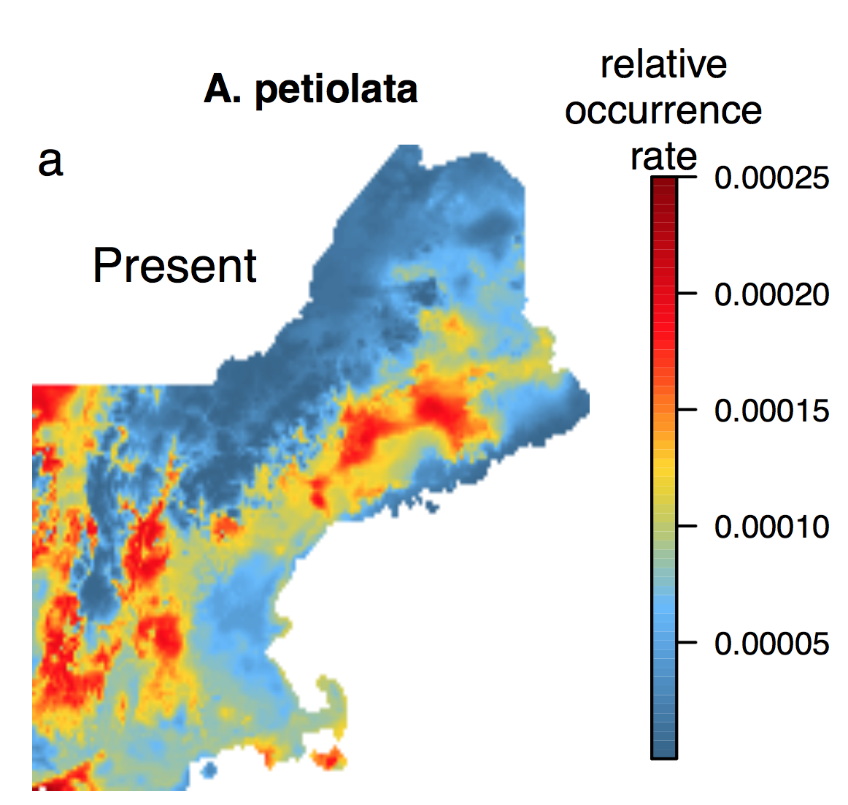
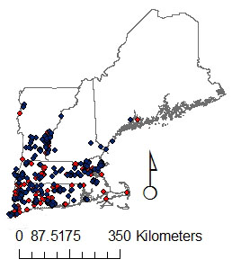
Invasions require extrapolation
Intro IPMs Invasion Future
What we ‘know’ already…
?
Occurrence
model
Notes:
Always extraplating in geographic space, often in environmetnal space too

Slide 47
Objectives
Intro IPMs Invasion Future
Are uninvaded regions suitable?
Will climate change affect native and invasive species similarly?
How can demography inform management?
What is the demographic basis for invasion?
Tower Mustard
Garlic Mustard
Notes:
1. too many other processes?
2. Future
3.Management
4. regionally specific management. Ecotypic variation

Slide 48
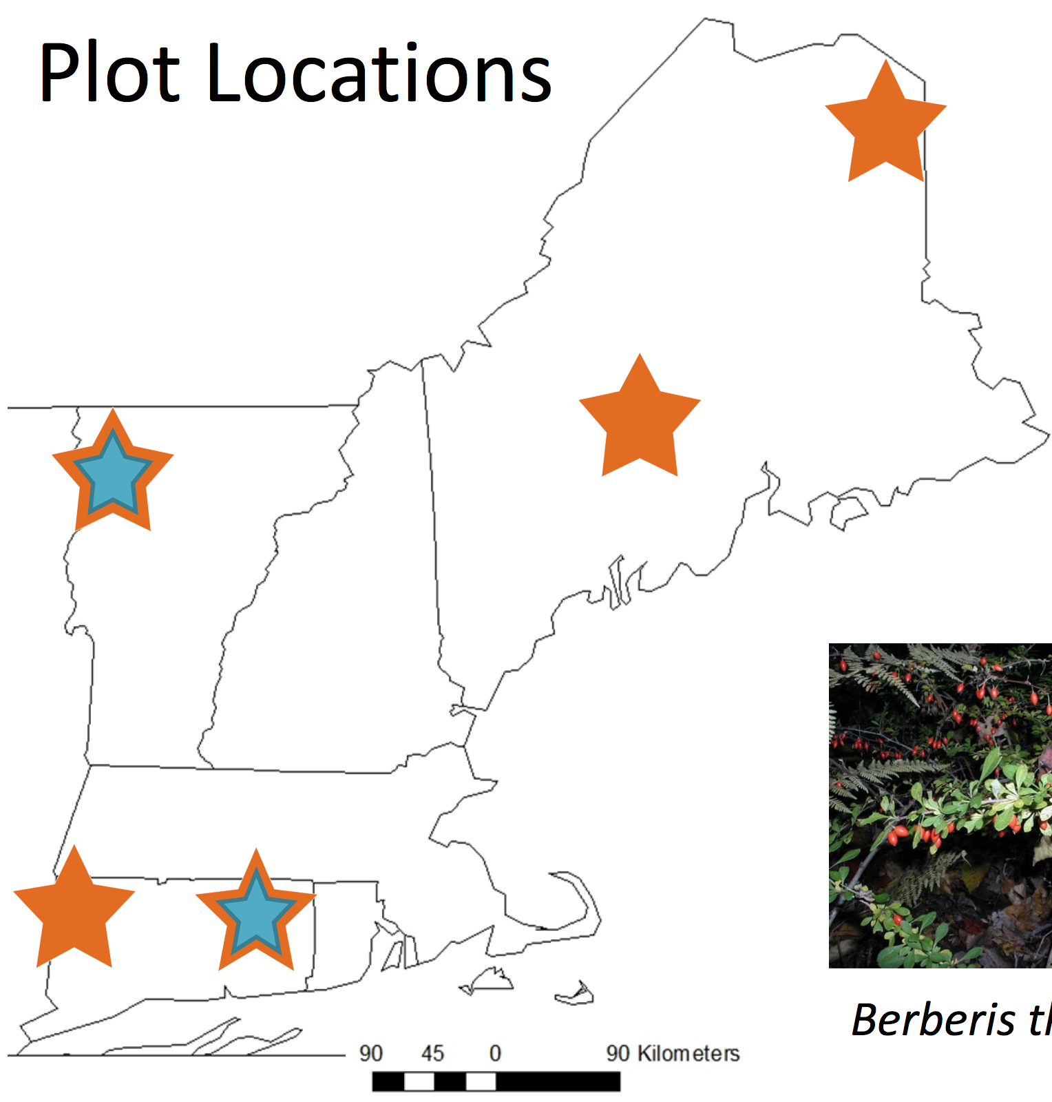
Data
Intro IPMs Invasion Future
Predictors
PAR (Light)
pH
Nitrogen
Temperature Warmest Month
May precipitation
21 plots
open/closed canopy
Notes:
Transplant in natural locations
Predicting ability to invade (5 generations)

Slide 49
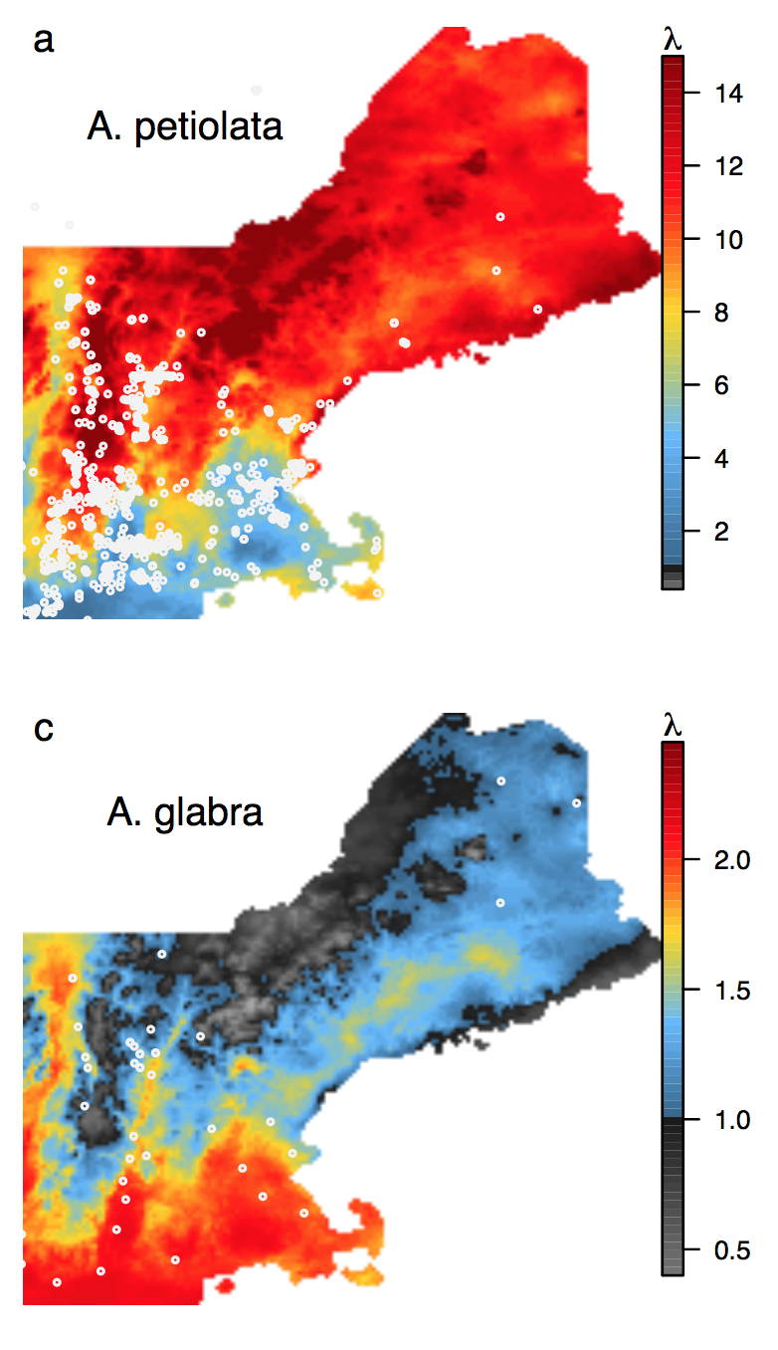
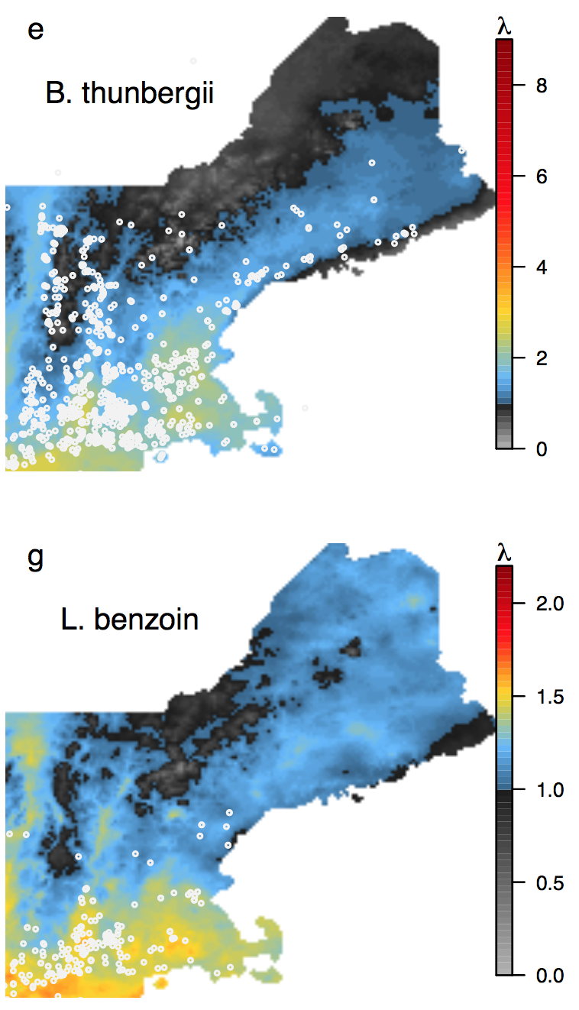
Validation
Intro IPMs Invasion Future
Invasive
Native
Notes:
Not a lot to go on, but getthing the spatial patterns right
Expain color scale

Slide 50
Validation
Intro IPMs Invasion Future
Invasive
Native
Notes:
Not a lot to go on, but getthing the spatial patterns right
Hey, this is a prediction, so validation isn’t really possible.

Slide 51
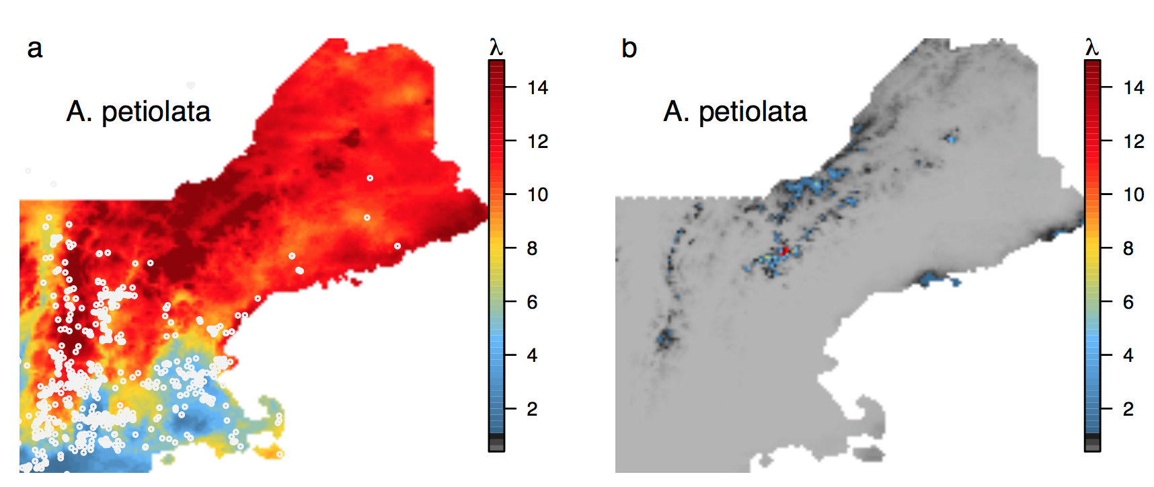
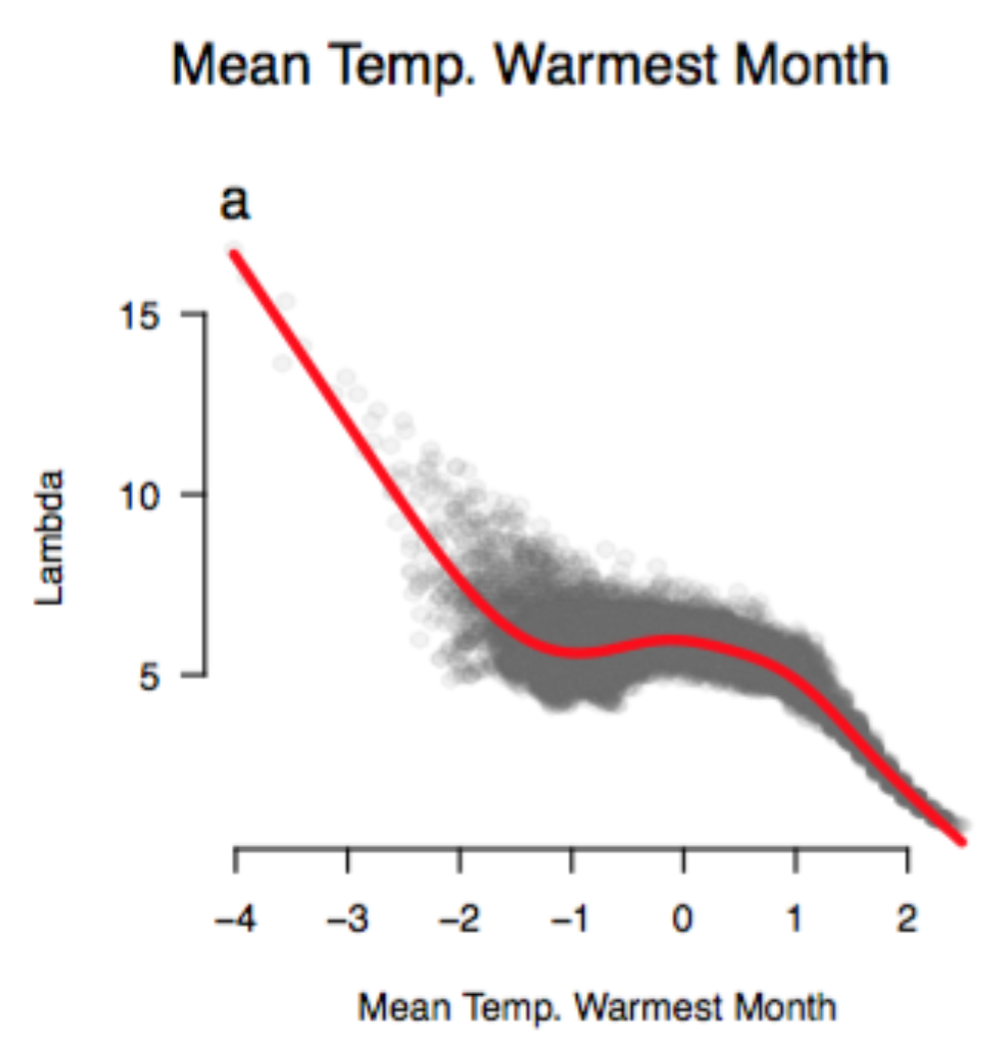
What drives the climate response?
Intro IPMs Invasion Future
Notes:
now focus on garlic mustard
So, what are the implications under future climate change

Slide 52
How will climate change impact invasion?
Intro IPMs Invasion Future
Present
2050 (RCP4.5)
Notes:
Rcp 4.5: mean .9-2 degree warming
Can’t establish.
There could be nice micro habitat still
Seed bank could help if there’s a nice year.

Slide 53
How will climate change impact invasion?
Intro IPMs Invasion Future
Growth
Size(t+1) ~ Size(t) + Environment
Survival
% Survival ~ Size(t) + Environment
Fecundity
Flowering Probability ~ Size(t) + Environment
Seeds/Individual ~ Size(t) + Environment
Germination ~ Environment
Offspring size
Size ~ Environment
All negative response to warmer temp.

Slide 54
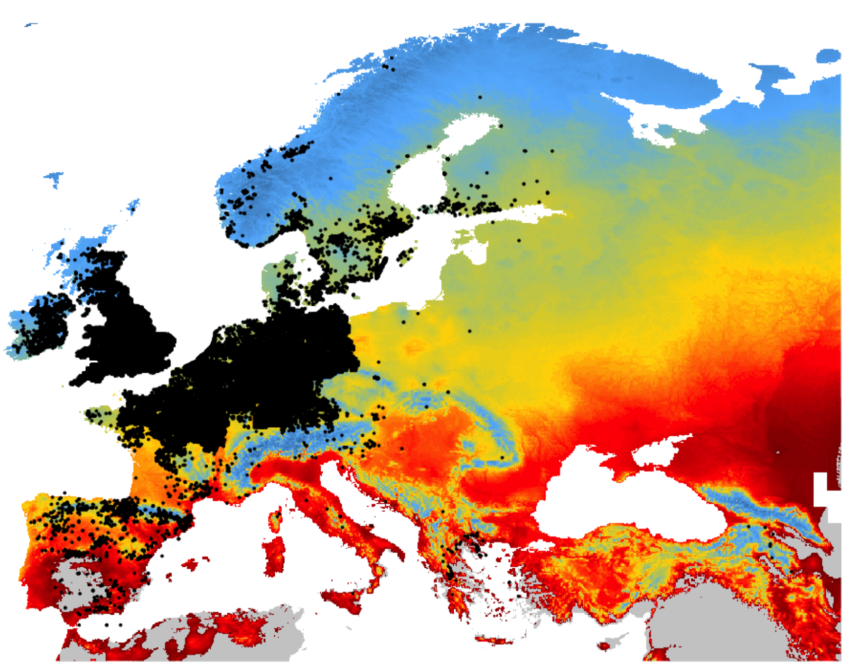
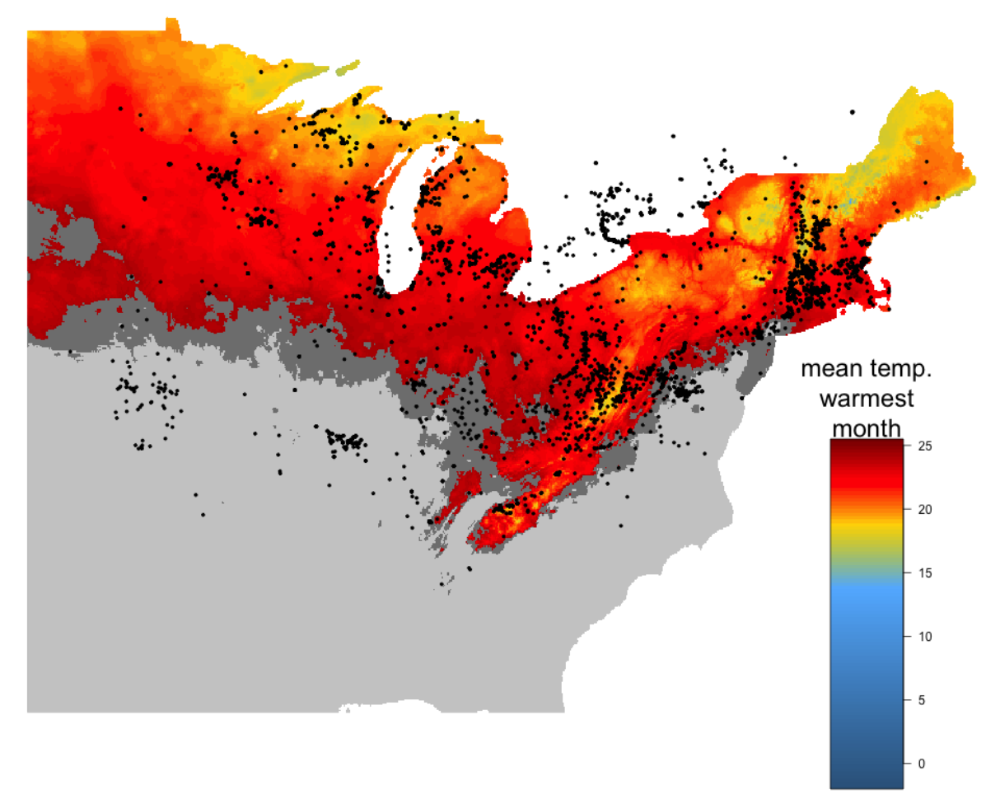
How will climate change impact invasion?
Intro IPMs Invasion Future
99.9% correct

Slide 55
How will climate change impact invasion?
Intro IPMs Invasion Future
89.9% correct
Notes:
Some of the highest fluctuations in temp in the country
Not accounting for any other predictors!

Slide 56
How will climate change impact invasion?
Intro IPMs Invasion Future
Present
2050
Notes:
So I’m not saying that climate change will take care of invasives for us, but that this shift the research agenda away from managing existing populations
Canada is in trouble – are there dispersal barriers?
How will less robust native species respond?
Garlic mustard modifies the soil – what will fill it’s gap? Another invasive?

Slide 57
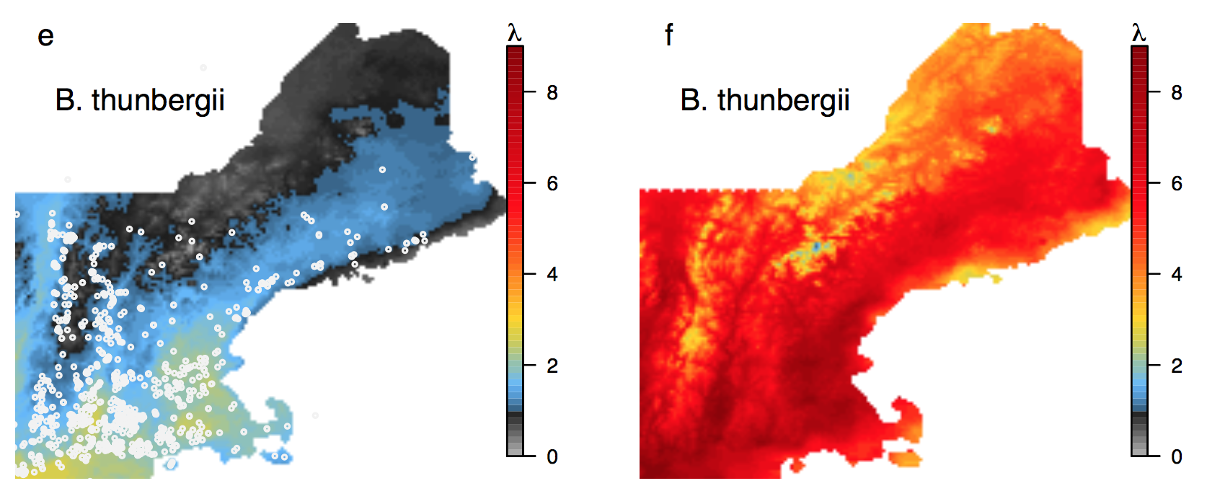
How will climate change impact invasion?
Intro IPMs Invasion Future
Barberry will get much worse!
Present
2050

Slide 58
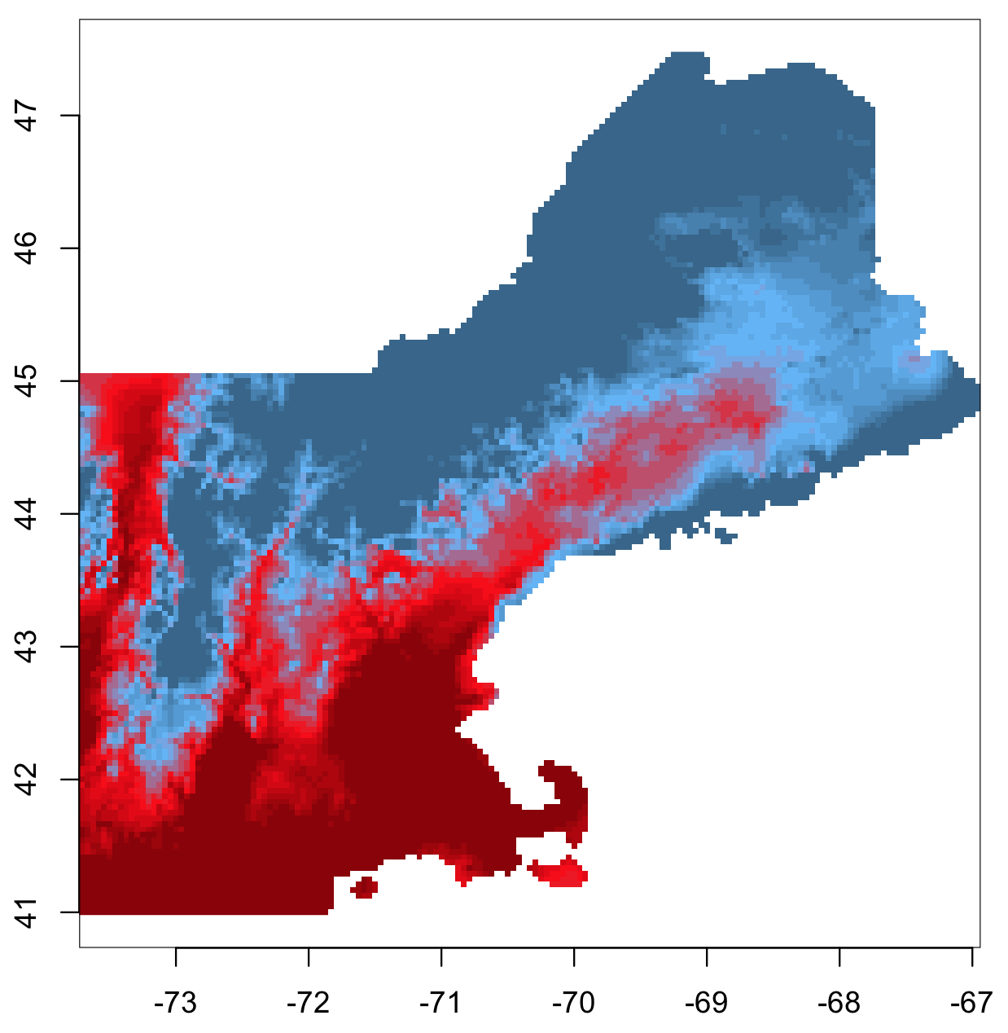
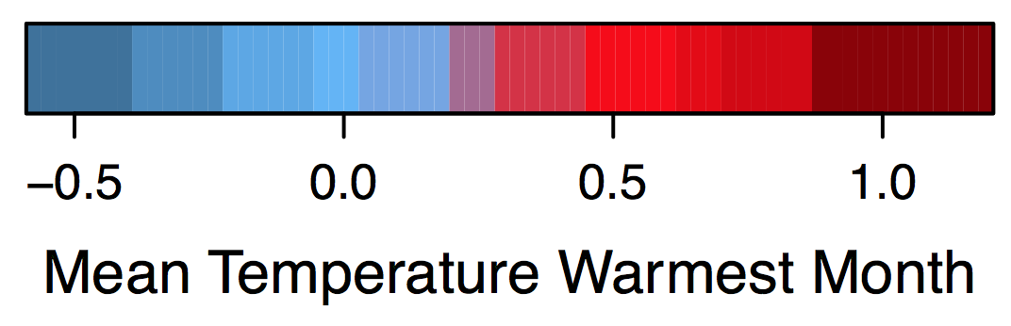
Introduction IPMs Invasion Forecasts
Invasive
Garlic mustard
Native
Tower mustard
closed canopy (forest)
open canopy (edge)
Notes:
advatange that we’re focusing on a single demographic process. This makes extrapolation
Focus on major differences in performance between native and invasive

Slide 59
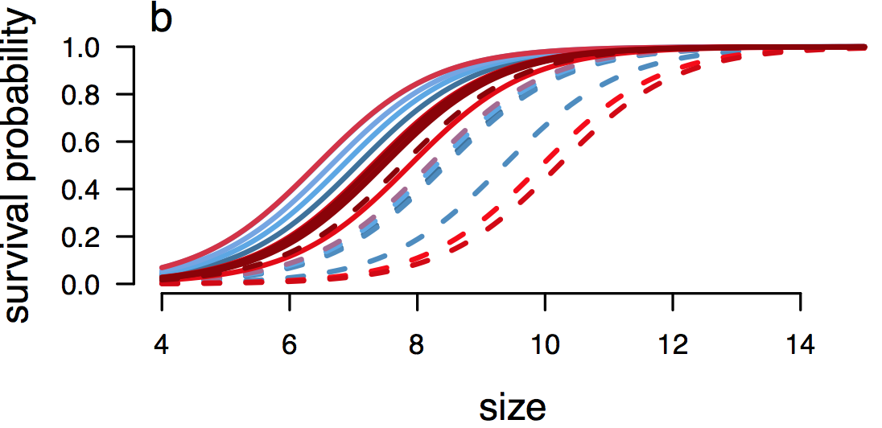

Introduction IPMs Invasion Forecasts
Invasive
Garlic mustard
Native
Tower mustard
closed canopy (forest)
open canopy (edge)
Notes:
advatange that we’re focusing on a single demographic process. This makes extrapolation
Focus on major differences in performance between native and invasive

Slide 60


Vital Rate Models
Introduction IPMs Invasion Forecasts
Invasive
Garlic mustard
Native
Tower mustard
closed canopy (forest)
open canopy (edge)
Notes:
Seed production is a good order of magnitude higher

Slide 61


Vital Rate Models
Introduction IPMs Invasion Forecasts
Invasive
Garlic mustard
Native
Tower mustard
closed canopy (forest)
open canopy (edge)

Slide 62

Garlic Mustard (Invasive)
Intro IPMs Proteas Invasion Future
Change to
P(lambda>1)
Closed Canopy
λ
Notes:
Let’s focus in on garlic mustard
patterns look pretty similar in both habitat types

Slide 63
Garlic Mustard (Invasive)
Intro IPMs Proteas Invasion Future
Closed Canopy
Open Canopy
λ
λ
Notes:
Let’s focus in on garlic mustard
patterns look pretty similar in both habitat types

Slide 64
Garlic Mustard (Invasive)
Intro IPMs Proteas Invasion Future
Closed Canopy
Open Canopy
λ
λ
Growth
Survival
Growth
Survival

Slide 65


Garlic Mustard (Invasive)
Intro IPMs Proteas Invasion Future
Closed Canopy
Open Canopy
λ
λ
Growth
Survival
Growth
Survival
Seeds
Seeds

Slide 66
Intro IPMs Proteas Invasion Future
Invasive
Garlic mustard
Open Canopy
Native
Tower mustard
λ
λ
Notes:
Caveats: early establishment lambda
Under good conditions of pH and N
The part on the grey scale is where it can’t survive

Slide 67
Intro IPMs Proteas Invasion Future
Invasive
Garlic mustard
Open Canopy
Native
Tower mustard
Make more
interesting
λ
λ
closed canopy (forest)
open canopy (edge)
Notes:
Caveats: early establishment lambda
Under good conditions of pH and N
The part on the grey scale is where it can’t survive

Slide 68
Intro IPMs Proteas Invasion Future
Data
Regression
Population
Structure
Vital Rates
Notes:
Workflow that starts with available data and uses new insights from modeling to Iteratively fill data gaps
Allowing us to make predictions that scale from individuals, through populations, to biogeographic patterns

Slide 69

Intro IPMs Proteas Invasion Future
Data
Regression
Population
Structure
Questions?
Vital Rates
Notes:
Workflow that starts with available data and uses new insights from modeling to Iteratively fill data gaps
Allowing us to make predictions that scale from individuals, through populations, to biogeographic patterns

